Slide 1
Bellringer: Feb 11
Intolerance is also known as being narrow-minded. Why do you think people might be intolerant of others?
Answer this question on the paper you picked up as you came in the classroom.

Slide 2
Unit 3: Intolerance
How does societal intolerance cause people to act in ways that others consider inherently evil?

Slide 3
What does it mean to be Intolerant?
1) Write down a description of what you see and/or what stands out to you.
2) Write down the message that you get from what you see.

Slide 4
Example 1: Internet Meme

Slide 5
Example 2: Comic Book Art 1949

Slide 6
Example 3: Bumper Sticker

Slide 7
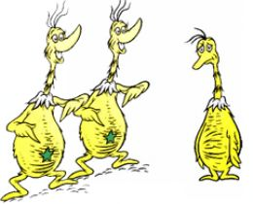
Example 4: The Sneetches
Notes:
You only need to show the beginning of the book video to get the message we’re looking for. ☺

Slide 8
Example 5:
Outside Little Rock Arkansas’ Central High School

Slide 9
What is intolerance?
Unwillingness to accept views, beliefs, or behavior that differ from one’s own.
Examples: Race, Age, Gender, Religion, Socioeconomic status.
Come up with three on your own and how do they impact today’s society

Slide 10
Culminating Project- Addressing Intolerance by Teaching Tolerance
Develop a PSA (PowerPoint,Video, Poster, Song/Rap/Jingle, or speech.
Student examples from previous years.
Bullying
Materialistic Clothing

Slide 11
Unit Lesson
We will be:
Analyzing and evaluating persuasion/argumentation
Analyzing diction and structure to create a theme
Analyzing organization of a text to create the central idea of the text

Slide 12
Youtube Examples
They Learn From You
Dear Parents
Bullying
Day of Silence (April 15, 2016)

Slide 13
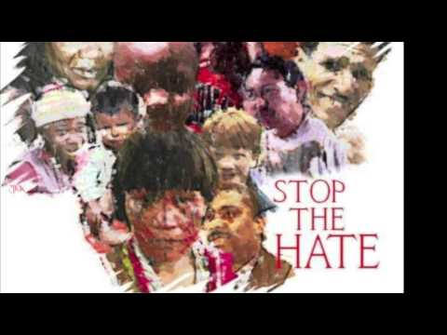
Poster examples

Slide 14
Discussion
What experiences do you think cause people to act intolerantly towards others?
What are some ways you could stand up to others who are being intolerant. If you have stood up for something right before, what did you do.
How can you teach tolerance?

