Slide 1
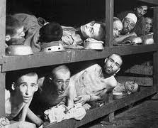
Bellringer: April 4
Write a brief paragraph describing what you see in this picture.

Slide 2
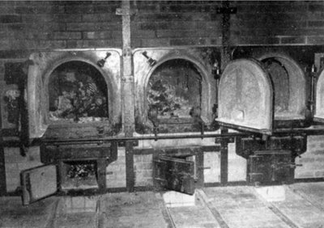
Crematories

Slide 3
Overhead view of Auschwitz

Slide 4
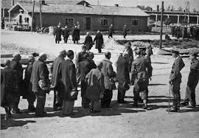
One of the ways the selection process occurred

Slide 5
Socratic Seminar
Inner Circle – you do the talking.
Outer Circle – you are coaches – you take notes on what is being said. If you want to add something, write it down.

Slide 6
Discussion 1
1 Despair Hope
2 Fear Courage
3 Torment Relief
4 Agitated Calm
Out of the four pairs, which set show the range of emotions in the text best? Defend your choice.

Slide 7
Discussion 2
Wiesel states “Just as despair can come to one only from other human beings, hope, too, can be given to one only by other human beings.”
How does the story we read support or contradict this statement?

Slide 8
Theme
With your partner, decide what the theme for this story is. Make sure it is a debatable opinion about humanity.

Slide 9
Now Write. Write as if your life depended on it.
How did Wiesel select, organize, and present details to create an emotional impact?
Use your notes, your text, your brain…
This response is due TODAY.
Next class we meet in S208 to CRUSH DCAS.

