Slide 1
BELLRINGER April 30/May1
What do you think are the United States’ strengths as a country or a people?
(You must come up with something!!!!!)

Slide 2
The Nuclear Threat
We will be examining how a Scientist and a Defense Secretary construct their arguments about the threat from nuclear arsenals.

Slide 3
Who
CARL SAGAN played a leading role in the American space program since its inception. He was a consultant and adviser to NASA since the 1950's, briefed the Apollo astronauts before their flights to the Moon, and was an experimenter on the Mariner, Viking, Voyager, and Galileo expeditions to the planets. He helped solve the mysteries of the high temperatures of Venus (answer: massive greenhouse effect), the seasonal changes on Mars (answer: windblown dust), and the reddish haze of Titan (answer: complex organic molecules).
For his work, Dr. Sagan received numerous medals and awards for his contributions to the development of planetary science… Many of the most productive planetary scientists working today are his present and former students and associates".
“Sagan has been enormously successful in communicating the wonder and importance of science. His ability to capture the imagination of millions and to explain difficult concepts in understandable terms is a magnificent achievement".
Dr. Sagan was the author of many bestsellers, including Cosmos, which became the bestselling science book ever published in English. He received twenty-two honorary degrees from American colleges and universities for his contributions to science, literature, education, and the preservation of the environment, and many awards for his work on the long-term consequences of nuclear war and reversing the nuclear arms race.
From: “Carl Sagan Biography.” The Carl Sagan Portal. Online. 2009. 28 April 2014.

Slide 4
Who
“Robert McNamara was a business executive, president of Ford Motor Company, U.S. secretary of defense, and president of the World Bank,
As secretary of defense during Kennedy's presidency, McNamara pressed for major organizational reforms of the defense department. He instituted a planning, programming, and budgeting system (PPBS) that was widely credited with challenging inter-department rivalries and achieving cost efficiencies.
He spoke out against "massive retaliation," a defense strategy that had emphasized the use of nuclear weapons as deterrents to communist challenges. McNamara supported rapid development of offensive nuclear weapons, notably Polaris missiles fired from submarines and land-based Minuteman missiles Along with the development of new weapons, a considerable expansion of the armed forces, and the arming and aiding of allies (such as the South Vietnamese), he also favored the “flexible response” strategy which promised to provide friendly nations with the means to establish "counterinsurgency," and to enable the United States to respond effectively to a wide range of military challenges, including "wars of liberation" abetted by China and the Soviet Union. Between 1961 and 1965 McNamara oversaw the largest peacetime increase in military spending--from $41 billion per year to $50 billion--in U.S. history.”
From “McNamara, Robert S.” American National Biography Online. Feb. 2000. Online. 28 April 2014.

Slide 5
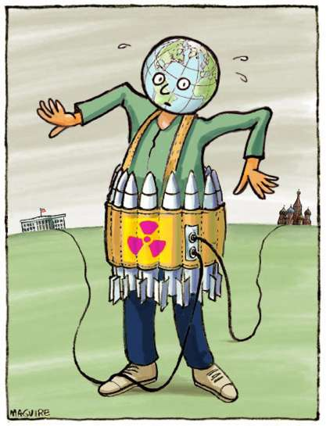
What: The Nuclear Threat
Imagine that a man wearing a TNT vest were to come into the room and, before you could escape, managed to tell you that he wasn't a suicide bomber. He didn't have the button to set off the explosives. Rather, there were two buttons in very safe hands. One was in Washington with President Obama and the other in Moscow with President Putin, so there was nothing to worry about. You'd still get out of that room as fast as you can!
Notes:
Could make into a button game.

Slide 6
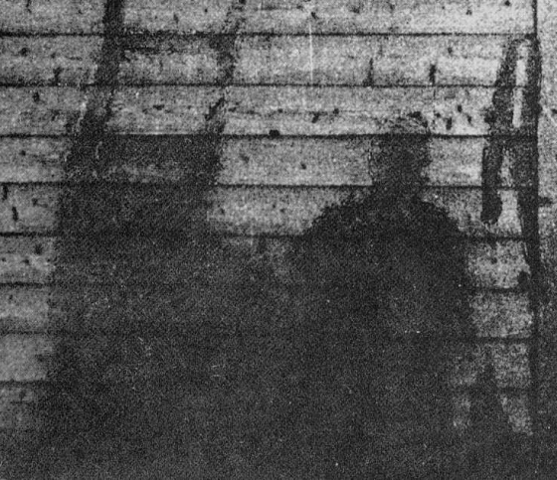
What?
Views of nuclear explosions

Slide 7
Stopping Nuclear Proliferation
Many more countries have nuclear weapons – England, France, China, India, Pakistan, Israel… and many more want them.
How do we stop this threat?
End ignorance about nuclear weaponry.
Nuclear Threat Initiative - devoted to expanding knowledge
http://nuclearrisk.org/ - This organization is devoted to educating people about nuclear weapons and stopping the spread of these weapons.
Watch this video - "How Risky are Nuclear Weapons?"

Slide 8
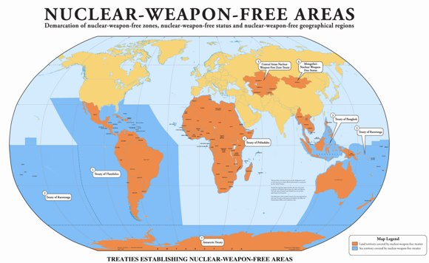
Proliferation
A rapid increase in numbers
We want nuclear proliferation to stop.

Slide 9
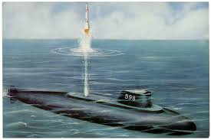
Polaris System
: A submarine launched ballistic weapons system. It went into service in the 1960 and heightened the Cold War nuclear threat.
first Polaris launch

Slide 10
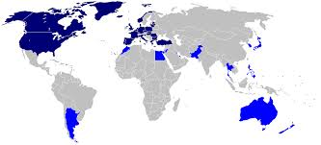
NATO
North Atlantic Treaty Organization. Members include USA, Canada, United Kingdom, most European countries including Italy, France, Greece, and Spain.

Slide 11
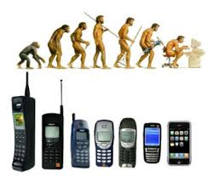
Precursor
a person or thing that comes before another of the same kind; a forerunner.

Slide 12
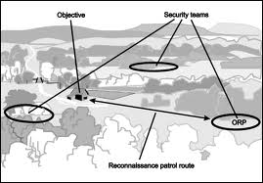
Reconnaissance
military observation of a region to locate an enemy or ascertain strategic features

Slide 13
Read both speeches
The speakers are facing an audience and must be able to capture the audience’s attention as well as make their claims clear.
They will use style devices such as repetition and parallelism. We saw those used in poetry also.
AS you read, pay attention to their use of repetition and parallelism. Write down the examples on your style chart and consider the effect each example creates.
Pay attention to how they develop their claim as well – check out how they provide evidence which leads to their inferences and claims.

Slide 14
Ticket out – April 30/May 1
What seems to be Sagan’s Main Idea so far? Be as specific as you can.

