Slide 1
Bellringer Oct. 19 Period 5 and 8
On the piece of scrap paper, write down what you understand about the unit project. You do have the directions already. Look in the writing section of your notebook.

Slide 2
Agenda – Period 7
Unit project – lesson 2 drafts due today.
Lesson 3 begin – “Dyaspora” reading
The Art of Hearing Heartbeats
You will need this book in class on Oct. 27.
You read “Dyaspora” (pronounced Die-as-per-uh) while I was out. Some of you turned in the packets. Some of you didn’t turn in the packets. Get them out now and turn them in right now with whatever you have finished on them.

Slide 3
Unit 1 project
Lesson one drafts are due on Wednesday, Oct. 21
Lesson two drafts are due on: Tuesday, Oct. 27
The overall unit project due date will be set closer to the end of unit 1.
We will be drafting the components as we finish each lesson.

Slide 4
Alternative Original poem (like “If”
If you can keep the ball when all about you
Are losing theirs and blaming it on you,
If you can kick a goal when all your teammates doubt you,
But realize you haven’t always been good too;
If you can run laps and not be tired by the run,
Or be sunburned, and but not be rash,
Or be sweaty, but not lose your fun,
And not look too proud, nor talk too much trash:

Slide 5
Unit Project Drafting
Lesson 2:
You must have:
1 - narrative entry which tells the story of the hobby or sport in which you have put in the most hours. (Ability?)
1 - narrative entry in which you describe an opportunity which you jumped on or maybe didn’t and wished you had. (opportunity)
1 - narrative entry about a time in your life when something lucky happened. Keep it school appropriate. (perhaps an Arbitrary Advantage?)
3 - entries which each focus on a different factor discussed in Freakonomics. Compare and contrast your opinion with the authors’ opinion on why this factor does or does not matter for success. These are NOT narratives but are exposition.

Slide 6
Lesson 2 model
EXAMPLE OF A HOBBY OR SPORT (Ability)
The first time I picked up a flute, in second grade, I knew that this was the instrument for me. My high school neighbor had come over to get me started. She showed me where my fingers went on the key pads; I could barely reach the far right keys. Then, the moment came which I knew would send me on my way. We began to play. The screech which emerged from that instrument was horrible. It was not the light and playful sound which Annika could produce. It was a horrible wail with no possibility of tune. She stopped us and readjusted how I was holding the instrument. We kept on. 10 years later, I was still playing, but as a soloist at the university. Through years of dedicated practice, I was one of the few who qualified for independent study and a place in the university band. I wouldn’t become a shining star because teaching was my future, but I gave a little light at one time.

Slide 7
Lesson 2 models
EXAMPLE FOR A FREAKONOMICS FACTOR
Child was spanked – doesn’t matter to early childhood test scores. I scored well in tests as a child and I was spanked. The discipline didn’t have an impact on me in school other than I knew not to misbehave and to listen to the teacher. I knew that deliberate disobedience at school or home would result in punishment at home. So I didn’t act up and I wasn’t disrespectful in school. I knew my purpose in being in school was to learn.

Slide 8
The question we answered last class is an assessment.
If you took your question home (How do the authors effectively structure their claim in Freakonomics?), you need to turn it in right now.

Slide 9
Moving on… LESSON 3
How does Joanne Hyppolite control structure, point-of-view and word choice to develop an argument in her narrative nonfiction piece, “Dyaspora”?
The unit board asks how does an author balance the development of details to create a theme. She does this through controlling structure, point-of-view and word choice. The unit board question has to apply to two or more different texts, so it is a more general question.

Slide 10
Take about 10 minutes and re-read the text.
If you don’t have your packet with you for whatever reason, grab a blue text book and turn to page 360 in the textbook. You’ll have to make notes on lined paper instead of in your packet.

Slide 11
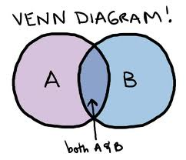
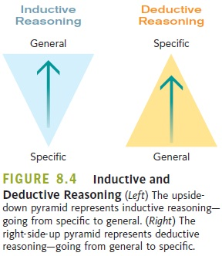
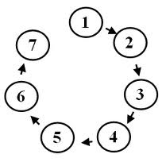
Part 1: Organization
You may remember being taught types of organization
Chronological
Compare and Contrast
Inductive
Deductive
Sequential
Spatial

Slide 12
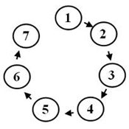
Organization
That doesn’t mean that writers are bound to these types
As we learned in the last lesson, most writing makes organizational decisions based on the author’s purpose, the intended audience, and the information that needs to be delivered.
A fiction story is usually chronological
Instructions are usually sequential
The chapter from Freakonomics was inductive overall, but compare/contrast in each section.

Slide 13
Organization
Organization is about looking at the information you have and thinking about the best order to give it to your audience.
The paragraph is the basic unit of organization.

Slide 14
Topic Sentences
How long is a paragraph?!
Your paragraph and its length are determined by their topic sentence.
A good topic sentence lets the reader know the content of the paragraph.

Slide 15
Let’s look back at the text!
Underline the topic sentences of each paragraph!
What is the organizational pattern you see here?
Why might the author choose this pattern? Discuss this with your partner for 1 minute before we come together as a class.

Slide 16
Exit Ticket:
Why is being able to organize your writing in an effective manner an important skill to improve?
Do the exit ticket on the paper and turn it in the exit ticket bin.

Slide 17
Where is the author’s claim or central idea stated?
Find the paragraph that tell us what her claim or central idea is. Be prepared to share out which paragraph it is and to defend your choice with evidence from the text.

Slide 18
Part 2: Point-of-View
The method of narration
There are three main types
1st person
3rd person
2nd person

Slide 19
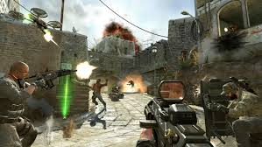
1st person
From the point of view of the author.
“I destroyed all the noobs.”
Good for letting you know the writer’s or main character’s true thoughts, and what it is like to be there.
These games are called First Person Shooters for a reason

Slide 20
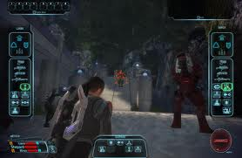
3rd person
From the point of view of someone watching the events from afar.
Limited-Don’t know everything
Omniscient-Knows everything
Good for showing numerous events in a text
“He decided staying home and playing Mass Effect was a better use of his time”

Slide 21
Let’s look back at the text: 2nd person
RARE!
Uses the pronoun “you”
“You are fighting a thousand bears, and you feel your strength failing you.”
An example from Dyaspora: “Your house in Boston is your island As the only Haitian family on the hillside you grow up on…”
AP 2: The question is...why use 2nd person? Discuss this with your elbow partner. Be prepared to explain to the class.

Slide 22
Part 3: Word Choice and Tone
Works on a spectrum of positive and negative connotations
Collective word choice creates tone
“I don’t like flamingoes. They are scary.”
“I detest flamingoes. They are terrifying”
“He gave her the present.”
“He tossed her the tattered gift.”

Slide 23
Let’s look back at the text!
Using the tone wheel, come up with a descriptive word that best describes each paragraph. Circle the words that contribute to your choice.
Do you notice any shifts in tone between paragraphs?
AP 3: How does the tone of each paragraph and the tonal shifts between those paragraphs help you understand about the author’s life?
Discuss this with your partner for two minutes.
Discuss as a class.

Slide 24
Discussion

Slide 25
LEQ 2-How does Joanne Hyppolite control structure and literary devices to develop an argument in “Dyaspora”?
We will be addressing this question in a formative quiz. The quiz will be open note and text which means YOU DON’T HAVE AN ENDLESS AMOUNT OF TIME!!!

Slide 26
Exit Ticket –
Why is being able to organize your writing in an effective manner an important skill to improve?

