Slide 1
Bellringer Oct 21 period 5 and 8
On the handout, combine the different sentences into one.
Example:
1. The dog ran.
2. The dog is black and white.
3. The dog greeted its owner.
New sentence: The black and white dog ran to greet its owner

Slide 2
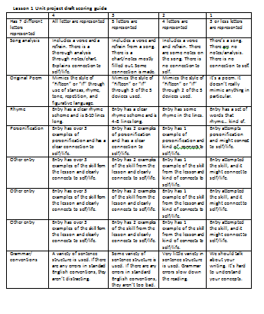
Rough draft of Lesson 1 unit project
STAPLE your draft together to the ROUGH DRAFT SCORING GUIDE.
This scoring guide has a BLANK back side.
MAKE SURE YOUR NAME AND CLASS PERIOD IS ON IT.

Slide 3
Period 5
Ms. Mathes is giving you a survey.
This information will help her get to know you better.
She will be working with us throughout the year.
She is an asset for you as she is another educated adult in the room to help you succeed.

Slide 4
Get out your “Dyaspora” packet
Where is her central idea?
How does her topic sentences help us understand her claim?

Slide 5
Part 2: Point-of-View
The method of narration
There are three main types
1st person
3rd person
2nd person

Slide 6
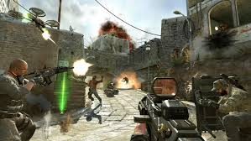
1st person
From the point of view of the author.
“I destroyed all the noobs.”
Good for letting you know the writer’s or main character’s true thoughts, and what it is like to be there.
These games are called First Person Shooters for a reason

Slide 7
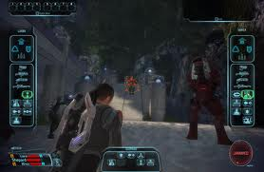
3rd person
From the point of view of someone watching the events from afar.
Limited-Don’t know everything
Omniscient-Knows everything
Good for showing numerous events in a text
“He decided staying home and playing Mass Effect was a better use of his time”

Slide 8
Let’s look back at the text: 2nd person
RARE!
Uses the pronoun “you”
“You are fighting a thousand bears, and you feel your strength failing you.”
An example from Dyaspora: “Your house in Boston is your island As the only Haitian family on the hillside you grow up on…”
AP 2: The question is...why use 2nd person? Discuss this with your elbow partner. Be prepared to explain to the class.

Slide 9
Part 3: Word Choice and Tone
Works on a spectrum of positive and negative connotations
Collective word choice creates tone
“I don’t like flamingoes. They are scary.”
“I detest flamingoes. They are terrifying”
“He gave her the present.”
“He tossed her the tattered gift.”

Slide 10
Let’s look back at the text!
Using the tone wheel, come up with a descriptive word that best describes each paragraph. Circle the words that contribute to your choice.
Do you notice any shifts in tone between paragraphs?
AP 3: How does the tone of each paragraph and the tonal shifts between those paragraphs help you understand about the author’s life?
Discuss this with your partner for two minutes.
Discuss as a class.

Slide 11
LEQ 2-How does Joanne Hyppolite control structure and literary devices to develop an argument in “Dyaspora”?
We will be addressing this question in a formative quiz. The quiz will be open note and text which means YOU DON’T HAVE AN ENDLESS AMOUNT OF TIME!!!

Slide 12
Homework
Work on the drafts for lesson 2 of the unit project.
Lesson 2 drafts are due Tuesday, Oct 27.

