Slide 1
BELLRINGER OCT 26: Write your response in your notebook. You’ll be adding to it.
What expectations do your parents have for you? How do those expectations fit with yours?

Slide 2
Finishing “Dyaspora” quiz
You have ten minutes to finish your quiz from the previous class.
MP 1 is over.
Don’t ask me about assignments which you didn’t do in MP 1.

Slide 3
Moving on…. LEQ 3B-Question: How does Sandra Cisneros carefully balance and organize the words and details used to explain her family's effect on her development? (organization, tone, imagery, point of view)

Slide 4
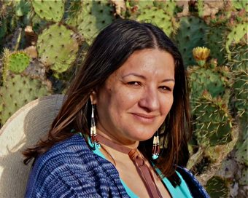
Sandra Cisneros
Writer
Sandra Cisneros is an American writer best known for her acclaimed first novel The House on Mango Street and her subsequent short story collection Woman Hollering Creek and Other Stories. Wikipedia
Born: December 20, 1954, Chicago, IL
Nationality: American
Awards: American Book Awards, MacArthur Fellowship, Lannan Literary Award for Fiction, Anisfield-Wolf Book Awards
Notes:
Stop – grammar fix up

Slide 5
Sandra Cisneros
Writes extensively about her experiences as a Mexican-American
Uses her distinct voice and style to separate herself from other writers
Watch this video and summarize the central idea and key points in your notes.

Slide 6
Important literature vocabulary
personal essay
point of view
organization of details (within her MOD)
word choice – which is used to create:
Tone
Mood
Imagery
Voice

Slide 7
Personal Essay
A piece of writing that explore a persons thoughts on a subject
Attempts to adopt a unique voice
It is NOT:
A fictional short story
Narrative Essay
Focuses on the meaning of events from own life
Carries a central idea which is like a theme
Notes:
Stop – grammar fix up

Slide 8
Organization
affected by information to share
the way details and ideas are sequenced and grouped
affected by targeted audience
Organization
May be implied or stated directly
Sequential
Compare/
Contrast
Chronological

Slide 9
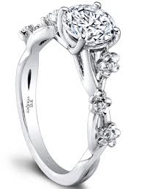
Details
These are the pieces that lead up to the whole
These are carefully selected by the author to shape the message or theme of an essay

Slide 10
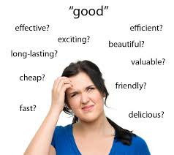
Word Choice
Connects to audience
The deliberate selection of words by an author
Relies on word connotations
Word Choice
Can reveal author’s feelings
Mood
Tone
Voice

Slide 11
SOAPSTone
SOAPSTone is a mnemonic device geared towards helping you know and understand how to analyze non-fiction texts.
The most difficult part of SOAPStone is the TONE part. Many students just identify the tone and leave it at that.
WRONG! In the TONE part, you have to analyze ALL the way the words are written to develop and indicate the tone and then explain how it connects to the Claim. It will be the LONGEST section by far.
Let’s watch this quick explanatory video (and you can then watch it again at home.)
Here’s another one for home

Slide 12
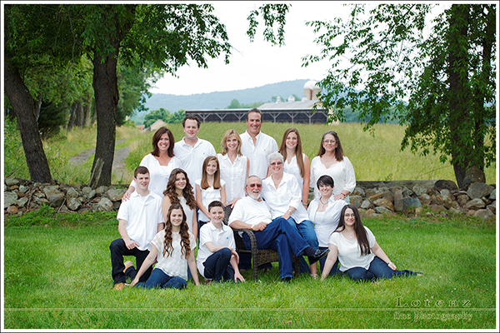
Previewing-What are the challenges of living in a big family?

Slide 13
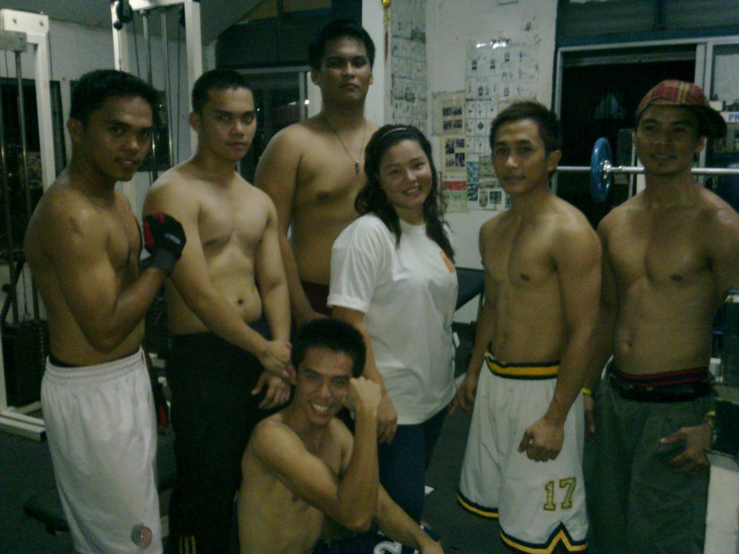
Previewing-What are the challenges where you are the only boy or girl?

Slide 14
Previewing-How might these challenges be different in different cultures?

Slide 15
Instructions
Today we will read “Only Daughter” by Sandra Cisneros.
You will be completing a reading guide
Follow the directions carefully
Everyone must read the whole text!
At the end, your reading guide will be used to write the answer to the LEQ.

Slide 16
Homework
Bring in The Art of Hearing Heartbeats for WEDNESDAY!!!!!!!!!!!!!!!!!!!!!

