Slide 1
Bellringer Dec. 16
In your notes, explain why Miss Emily didn’t have to pay property taxes when everyone else in the entire country has to or they will lose their home?
Is the reason true?

Slide 2
How does Faulkner use subtle details and characterization to comment on the difference between perceptions and reality?
“A Rose for Emily”
By William Faulkner
Notes:
Looking at little differences – leading into subtle details and implications

Slide 3
Sketch the woman described below.
“They rose when she entered--a small, fat woman in black, with a thin gold chain descending to her waist and vanishing into her belt, leaning on an ebony cane with a tarnished gold head. Her skeleton was small and spare; perhaps that was why what would have been merely plumpness in another was obesity in her. She looked bloated, like a body long submerged in motionless water, and of that pallid hue. Her eyes, lost in the fatty ridges of her face, looked like two small pieces of coal pressed into a lump of dough as they moved from one face to another while the visitors stated their errand.”
Notes:
Make this a handout.

Slide 4
Social customs?
In the south during the setting of this story, there were social customs which “normal polite” society observed.
A. Read the excerpt from Judge Till’s essay, “Manners, Morals, Customs, and Public Perception”
B. Read the excerpt from “How to be a Southerner”
Notes:
A = more advanced readers. B = more reluctant readers.
Both texts are included in the resources. Text A has been excerpted.

Slide 5
STORY VOCABULARY!
Notes:
Maybe do this with kids who needs these words explained specifically – put up as groups get to these words.

Slide 6
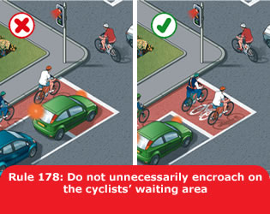
Encroach

Slide 7
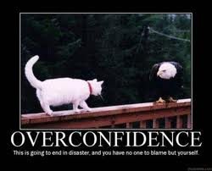
Temerity

Slide 8
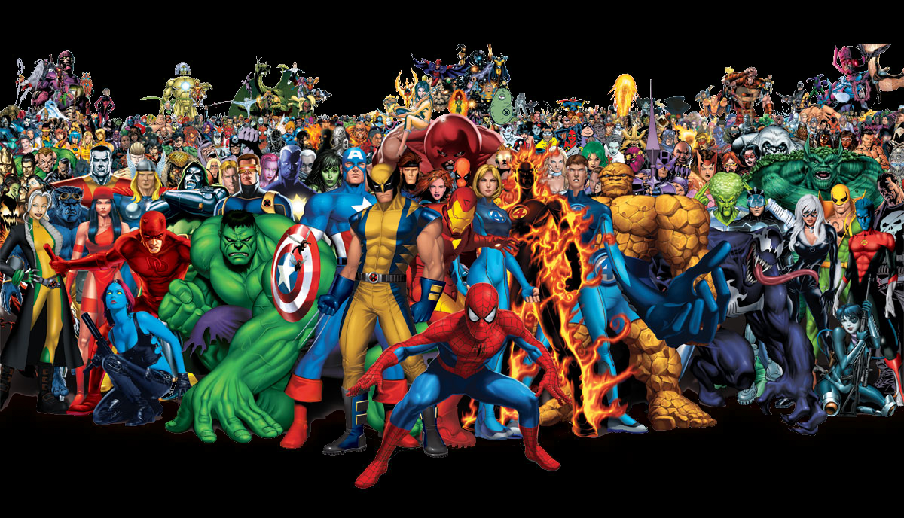
Cabal
Notes:
Cah-BALL

Slide 9
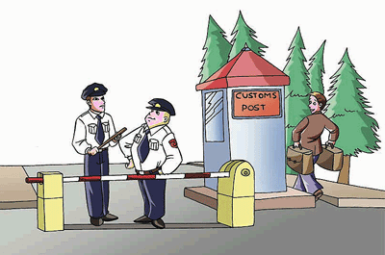
Circumvent

Slide 10
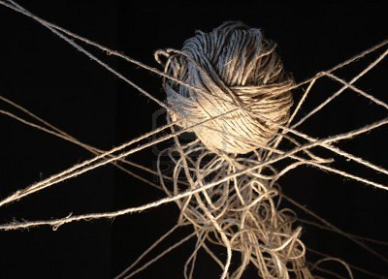
Inextricable

Slide 11
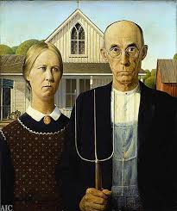
Tableau

Slide 12
Virulent

Slide 13
Reciprocal Teaching
Follow the directions for Reciprocal Teaching.
Write your group’s summaries in your notes.
Be ready for the class discussion.
Notes:
There is a ppt for teaching how to do reciprocal teaching.

Slide 14
Reciprocal Teaching Cycle
Predict
Read Silently
Question
Clarify
Summarize
Switch Teachers
Evaluate the Prediction

Slide 15
Homework for Friday
Finish reading the story and doing your summaries.
You will talk about the sections when we have class on Friday.

