Slide 1
Bellringer: Dec. 3
Complete the inference activity. Be prepared to share out and to submit the Bellringer.

Slide 2
Making inferences (review)
What is an inference?
It is a logical guess using evidence from a text, your own knowledge, and common sense.
(When you use inference about the future, it is prediction.)

Slide 3
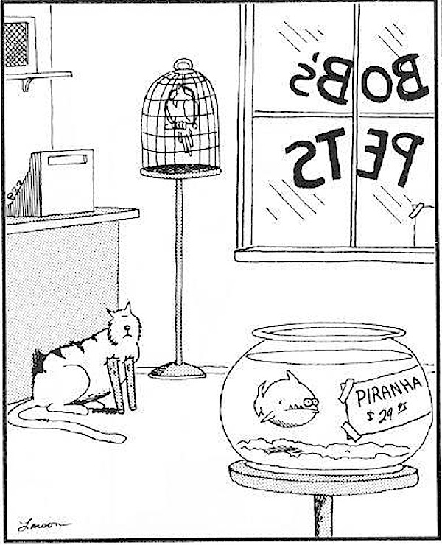
Observation vs. Inference
what you figure out
what you
see

Slide 4
Strategies for Making Inferences:
Look for details that reveal important aspects of setting, plot, and character.
Use common sense and prior knowledge to make connections.
Analyze a character's actions and words to determine his or her values.
Pay attention to how the narrator or characters make inferences.
Analyze your thought process and determine whether or not you are using faulty logic or jumping to conclusions.

Slide 5
Character and tone charts
When you are finished reading and answering the questions, complete the character and tone charts.
The charts will be the notes you may use on the quiz we will take next class on “The Possibility of Evil”
You do have an exit ticket.

Slide 6
Exit Ticket
How would you characterize Miss Strangeworth now?
What in the text showed you that inference?

