Slide 1
Bellringer: JaN 6
Find your new seat
Read the Article “How the Internet is Rewiring your Brain”
Choose which of the five facts you agree with more and be ready to defend your position. (This means you should spend some time reading the information instead of sitting there talking and/or staring off into space.)

Slide 2
With your Partner
With your device, look up SeaWorld’s web page.
Find one piece of information which SeaWorld uses to explain how they help sea animals and improve the world
Be ready to share out this piece of information

Slide 3
With your partner
With your device, look up Sea World of Hurt’s webpage.
Find one piece of information which this site uses to explain how Sea World doesn’t help animals or the world
Be ready to share out this piece of information

Slide 4
Which site is accurate and how do we know?
One is an entertainment corporation with some research facilities
One is an activist animal rights organization known for its extreme methods of protesting
Both have their own agendas
Both use the media to persuade
Both use rhetorical devices in their persuasion
Who is more credible?

Slide 5
Blackfish
A Rhetorical Analysis

Slide 6
What are you going to do?
Watch Blackfish to carefully analyze the use of rhetoric to make a claim.
Read and view Sea World’s rebuttal and evaluate the use of rhetoric to defend the accusations brought in the film
Evaluate the components of each argument in a critical way
State your beliefs about this issue after careful analysis
Notes:
Do the four corners activity here.

Slide 7
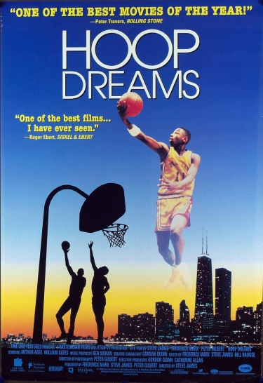
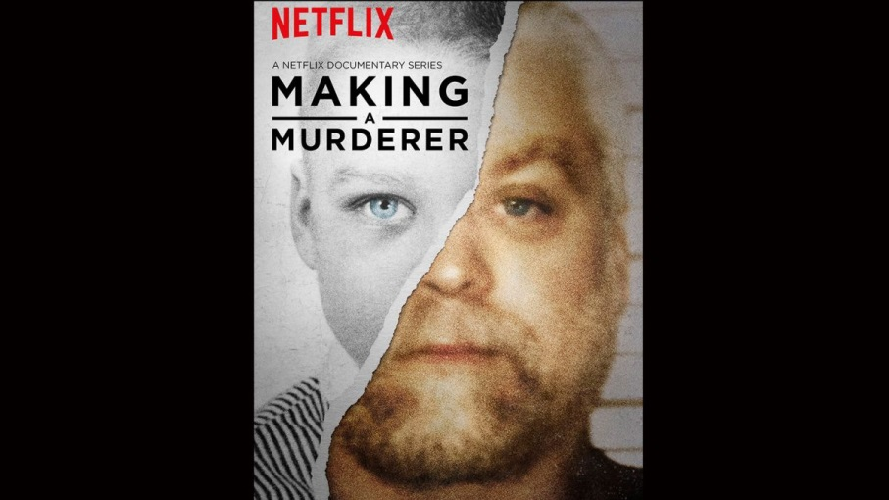
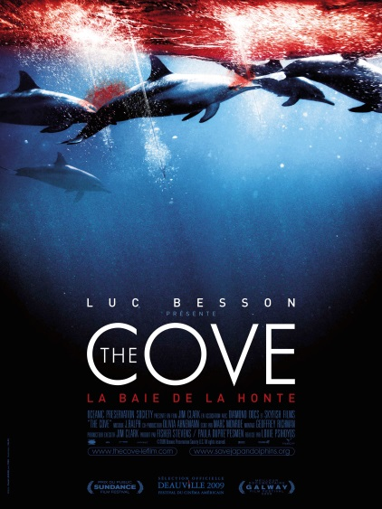
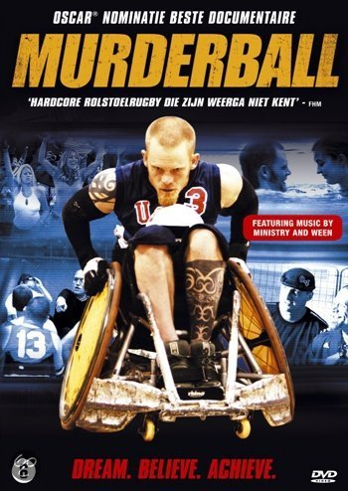
What is a Documentary? (No, they’re not all boring…)
A documentary film is a movie that attempts to document reality. Even though the scenes are carefully chosen and arranged, usually through editing after filming, they are not scripted and the people in the movie are not typically actors. Sometimes, a documentary film may rely on voice-over narration to describe what is happening in the footage; in other films, the images speak for themselves without commentary. A documentary often includes interviews with people in the film for additional context or information.

Slide 8
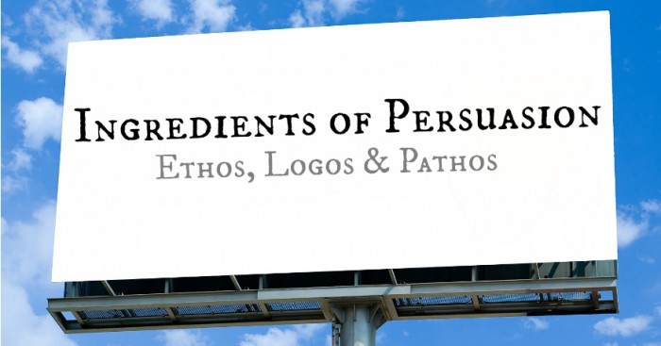
What is rhetorical analysis?
Rhetoric is a term that is broadly used, but its most classical definition is the art of persuasion. If you are asked to write a rhetorical analysis, you are really being asked to identify the particular strategies that an author is using to appeal to or persuade a given audience.

Slide 9
Pathos—emotional appeal
How does the filmmaker use emotion to grab the attention of the audience?
To have the audience form a favorable opinion about her stance on killer whales in captivity?
Is her use of pathos effective? Ineffective? Over-the top?

Slide 10
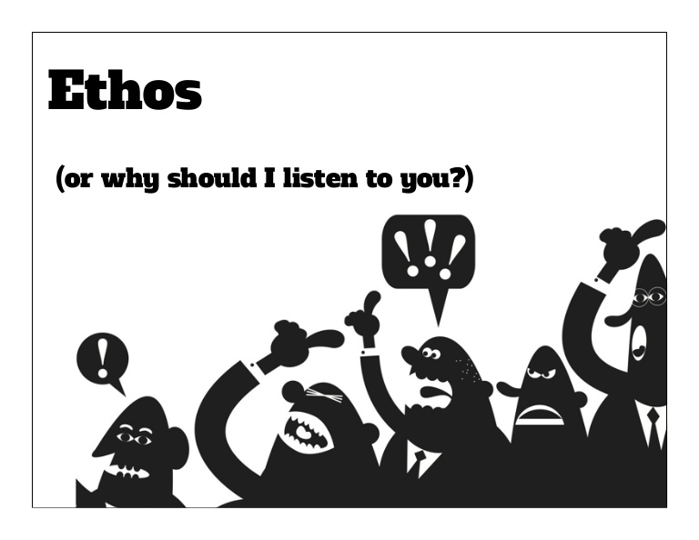
Ethos—credibility of author
Who is the director of the film? What are her credentials? What is her background? Why was she interested in making this film? How does she establish authority?
Who are the people interviewed in the film? What is their professional background? Do they have affiliations that would make their testimony in the film suspect?
What kind of bias—if any—did you discover in the film?

Slide 11
Logos—appeal to logic
Identify the intended purpose of the film.
How does the director achieve this purpose?
Is her evidence based on reason? Is it presented in a logical order?
What facts and data does she use?

Slide 12
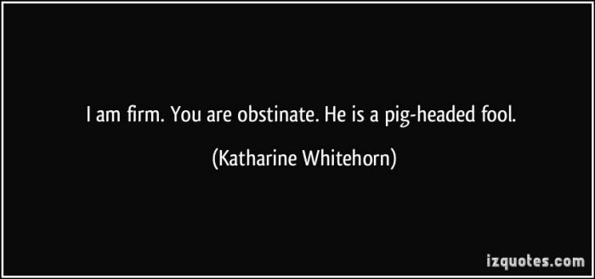
Loaded language
Diction that carries a heavy emotional charge
Emotional argument made using loaded language are particularly effective because they exploit the human weakness for acting immediately based upon an emotional response, without considering logic and reason

Slide 13
Film as persuasion
What effects does the film maker use to guide the audience?
How does she transition from one topic to another?
What images are repeated over and over?

Slide 14
Logical Fallacies:
The ability to identify logical fallacies in the arguments of others, and to avoid them in one’s own arguments, is both valuable and increasingly rare. Fallacious reasoning keeps us from knowing the truth, and the inability to think critically makes us vulnerable to manipulation by those skilled in the art of rhetoric.
What is a Logical Fallacy?
A logical fallacy is a flaw in reasoning. They are often used by politicians, corporations, and the media to fool people.

Slide 15
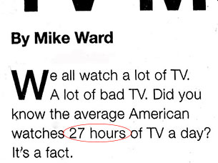
Logical Fallacies (CONT):
Testimonial—persuading by invoking support from respected individuals—athletes, movie stars, doctors—or institutions
Repetition—persuading through repeating the same image, word, symbol or phrase over and over
Ex: broadcasting the same commercial at each commercial break
Hyperbole— exaggerated claim

Slide 16
Period 2 stopped here on Jan. 6

Slide 17
LOGICAL FALLACIES (cont):
Either/Or—a claim that there are only two choices when there are more. Used constantly by the media
Stacking the deck/Card stacking—taking information out of context or not providing the whole story
Ex: Gamblers 'stack the deck' in their favor by arranging the cards so that they will win. Writers 'stack the deck' by ignoring any evidence or arguments that don't support their position. I once experienced 'stacking the deck' when I went to buy a used car. The man trying to sell me the car talked only about how wonderful the car was. After I bought the car, another man tried to sell me an extended warranty by pointing out all the things that could break down." (Gary Layne Hatch, Arguing in Communities. Mayfield, 1996

Slide 18
LOGICAL FALLACIES (CONT):
Hasty Generalization – a generalization based on too little evidence
Ex: My father smoked four packs of cigarettes a day since age fourteen and lived until age sixty-nine. Therefore, smoking really can’t be that bad for you.
Oversimplification—offering a simple solution to an extremely complex problem

Slide 19
LOGICAL FALLACIES (CONT):
Red Herring – something that misleads or distracts from a relevant or important issue

