Slide 1
BELLRINGER: May 22/23
What is the follow video criticizing about our society?
FWP
Be prepared to share your response.

Slide 2
Laughing At the end of the world
Satire in film as social commentary

Slide 3
Satire
is a genre of literature, and sometimes graphic and performing arts, in which vices, follies, abuses, and shortcomings are held up to ridicule, ideally with the intent of shaming individuals, corporations, government or society itself, into improvement. Although satire is usually meant to be humorous, its greater purpose is often constructive social criticism, using wit as a weapon and as a tool to draw attention to both particular and wider issues in society.

Slide 4
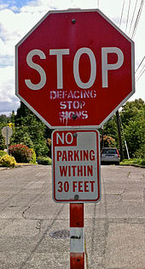
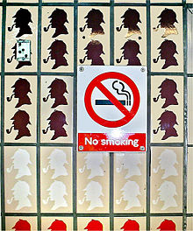
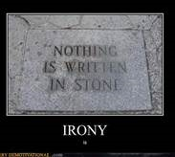
Irony and Satire: BFF
A feature of satire is strong irony or sarcasm
And in case you forgot, irony is a contrast of expectation of a situation and the reality.

Slide 5
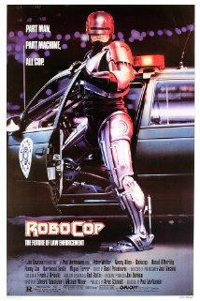
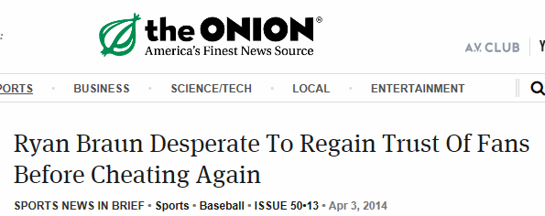
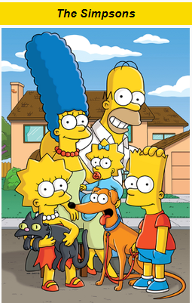
Popular Satires

Slide 6
Wait, Nagy, Was that Robocop?
Yup, even an ultra-violent action movie can be a satire.
Parts of the movie are so over-the-top that they become clearly ironic.
One part of the film actually has Robocop “walk on water.” You know…like Jesus
People have actually written academically about the social critique offered by a movie about a Robot Police Man who—at one point—stabs a man in the neck with a spike.
“While Robocop offers a vigorous critique of capitalism as an yinhuman, ruthless, and corrupt society (as represented in the figures of Jones, Morton, and Boddicker), its critique is also directed against technology. In the paranoid, technophobic world of Robocop, technology is out-of-control. Throughout the film we see the human world trying to master nature but ultimately failing. Thus, the numerous failures of ED-209, the power failure at the SDI space station and its subsequent misfires, the return of Robocop's memory and former identity despite computerized programming -- all signal the film's critique of technological reification as a flawless cybernetic control over the human lifeworld, albeit one already integrated with technology. “

Slide 7
Why Satire?
Check the first slide again:
“its greater purpose is often constructive social criticism, using wit as a weapon and as a tool to draw attention to both particular and wider issues in society”
Oversimplification:
People will pay attention to what you are saying because you do it in a clever, and/or humorous way

Slide 8
Quick Check
Based on the criteria here:
Come up with an example of satire
Think about the creator’s message
Share with your partner
Be able to explain why your partners answer is an example of satire.

Slide 9
Dr. Strangelove: or How I learned to stop worrying and love the bomb
First some historical terms you need to know:
Cold War
Nuclear Weapons
Mutually Assured Destruction (MAD)
Missile Gap
Doomsday Machine
Fallout

Slide 10
Cold War
A war that is waged without open combat between two groups
A conflict between NATO (US and allies) and the Warsaw Pact (Soviet Union and its allies)
Originated from the following quote: “For forty or fifty years past, Mr. H. G. Wells and others have been warning us that man is in danger of destroying himself with his own weapons, leaving the ants or some other gregarious species to take over. Anyone who has seen the ruined cities of Germany will find this notion at least thinkable. Nevertheless, looking at the world as a whole, the drift for many decades has been not towards anarchy but towards the reimposition of slavery. We may be heading not for general breakdown but for an epoch as horribly stable as the slave empires of antiquity. James Burnham's theory has been much discussed, but few people have yet considered its ideological implications—that is, the kind of world-view, the kind of beliefs, and the social structure that would probably prevail in a state which was at once unconquerable and in a permanent state of "cold war" with its neighbours.” -Orwell

Slide 11
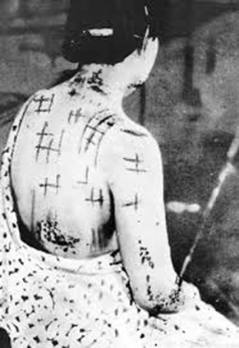
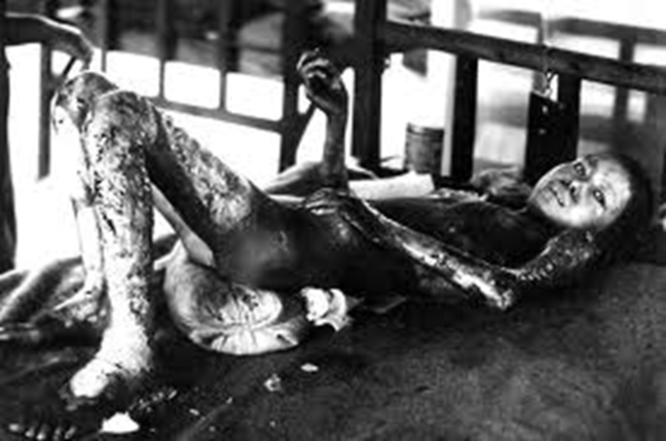
Nuclear Weapons
http://www.youtube.com/watch?v=ltK7ClQW6Lw
Or
http://www.youtube.com/watch?v=thPfjOt5WEo

Slide 12
Fallout and Nuclear Winter
Nuclear weapons have a different effect than normal explosives. They are far more insidious.
Fallout is residual radioactive material propelled into the upper atmosphere following a nuclear blast or a nuclear reaction conducted in an unshielded facility, so called because it "falls out" of the sky after the explosion and shock wave have passed.
Can cause: immediate death, cancers, birth defects...
Nuclear winter-the theory that detonating a number of nukes could block out the light and cause severe climate change for years, disrupting the food chain.

Slide 13
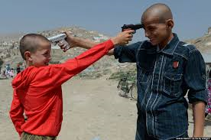
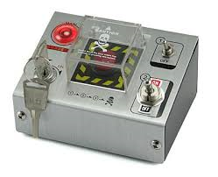
M.A.D. and the Doomsday Machine
Mutually Assured Destruction (MAD)-the idea that no side will begin a nuclear war because, in the event of a nuclear war, both sides will be completely destroyed regardless of who attacks first.
Doomsday Machine-a machine that could automatically bring about the end of human life. The idea is that no side would dare attack because the doomsday machine would kill everyone.

Slide 14
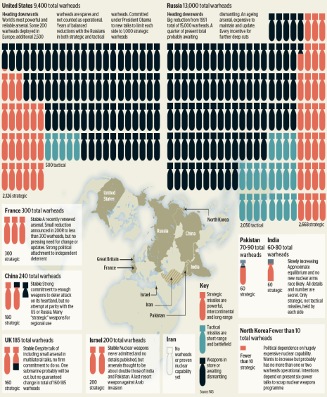
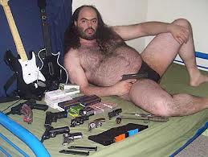
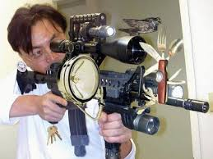
Arms Race/Missile Gap
The idea that one side shouldn’t get ahead in military capability
The missile gap was the Cold War term used in the US for the perceived superiority of the number and power of the USSR's missiles in comparison with its own.
Like the bomber gap of only a few years earlier, it was later demonstrated that the gap was known to be illusionary from the start, and was being used solely as a political tool, an example of policy by press release.
Versus

Slide 15
Nagy! I’m depressed now. When does the laughing happen?
Because humans were finally looking at the possibility of the end of the world, American culture became obsessed with nuclear weapons.
Many wrote stories about living in a nuclear crisis. Many did so in order to get people to think about the immense danger we were living in.
Three famous novels: Alas, Babylon; Red Alert; and Fail Safe all deal with a nuclear crisis seriously.
Dr. Strangelove is based on Red Alert, but the director decided to highlight the absurdity of the situation to highlight the dangers of nuclear war.

Slide 16
What we are doing?
Watch Dr. Strangelove
Complete viewing guide (except the character chart)
Compare viewing guide with classmates to fill in holes
Notes:
Don’t go on to the next slide until after you view the film and answer the film reading questions.

Slide 17
Now that the film is over
Some little extra tidbits for you:
Look at the names:
General Turgidson-Turgid means swollen or full of pressure
Col. Mandrake-a mandrake root is said to grow where a hanged man…um…”drops his seed”
Pres. Merkin Muffley-a merkin is a wig for…down there. The last name…well…you can probably infer what that is.
Col. Jack Ripper-Do I need to spell it out? Fine, Jack the Ripper killed prostitutes in England.
Premier Kissoff-Really?
Col. Bat Guano-This translates to Bat S#%T in Spanish, which is generally only said in reference to insanity
Have you noticed any patterns?

Slide 18
Character Chart
It is too easy to say that the theme of this movie is that nuclear war is absurd. We need to take a closer look at what the director thinks makes nuclear war absurd.
Take the information from the viewing guide and combine it with the information about the names we just looked at.
Fill in the chart for each character.

Slide 19
Put it all Together
LEQ: How does Stanley Kubrick use satire to construct his argument about the dangers of nuclear war?

