Slide 1
Bellringer: May 13
IN YOUR NOTES!!!!!
What style elements of Sagan’s writing makes his speech easy to remember or make his points stand out?
(style elements, you know, things like repetition, imagery, figurative language – stuff we’ve been talking about and analyzing all year! – stuff that you should know about without my reminding you because you are intelligent human beings who will make a difference in the world and not entitled spoiled brats who will be a drain on society.)

Slide 2
During Reading Directions
We are going to read this text using reciprocal teaching.
The text is marked in order to tell you where to break and have discussion
Focus your questions to the reasoning behind the various appeals that Sagan makes.
Set a purpose: We are going to compare and contrast the two speeches and their attempts to appeal to their respective audiences.

Slide 3
Predict
Switch Teachers
Read Silently
Summarize
Evaluate the Prediction
Clarify
Question

Slide 4
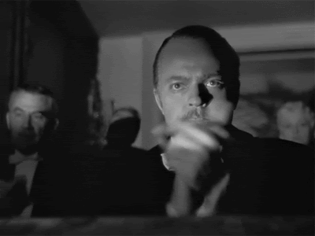
Vigorously
DEFINITION: doing with a great deal of energy.
EXAMPLE: He vigorously scrubbed the stain on his shirt until it was gone.
IN TEXT EXAMPLE: ”We initiated and vigorously pumped up an arms race with the Soviet Union.”

Slide 5
Assertions
DEFINITION: a confident statement or claim.
EXAMPLE: The phone company made several assertions about the reliability of the network.
IN TEXT EXAMPLE: In the preceding year, confident assertions, were made by officials of both nations that no accidents of that sort could occur.

Slide 6
AFTER READING
Now that we have taken a look at the works and the vocab, we are going to answer the following question.
Which speech is more constructed more effectively? Compare and contrast them. Hint – organize it by ideas instead of by sources.
Keep in mind:
Audience
Purpose
Specific claims
Ethos (creating and maintaining)
Use of logos and pathos

Slide 7
Homework
Finish the Response. Bring it with you by TUESDAY, May 19.
Upcoming:
On Friday, we must take the State Mandated POST test for ELA 10th grade. If you are absent, you will be required to make it up before school the following week. Don’t be absent.
This POST-test is an in-class essay.
You don’t get extra time unless you have a CKU class.
Come prepared to knock the socks off of this writing skills test. Bring your writing A-game.

