Slide 1
Bellringer: IN YOUR NOTES May 14
How are the terms “Missile Gap,” “Arms Race,” “Mutually Assured Destruction,” and “Cold War” connected? Write a sentence which connects them meaningfully.

Slide 2
To Nuke or to not to Nuke (part 1)
Looking at speeches that argue for and against spending on nuclear weaponry.

Slide 3
In preparation for today,
You were to:
A: view the background information on weebly.
B. Read Reagan’s speech.
C. Come prepared to discuss.

Slide 4
Quietly, without help from each other.
Identify:
1. What is Reagan attempting to convince us to do
2. What are his main reasons for needing this
3. What emotions does he want us to feel.
4. What makes him believable or not.

Slide 5
Discuss in your groups:
Is Reagan effective?
What makes him effective (or not)?
What makes him believable or not?
Elect one person to be your spokesperson to report out.

Slide 6
Challenges for President Reagan
1. Humans are bad with abstractions.
He needs to explain what the big numbers and the percentages in the budget debate really mean
2. Nuclear war is terrifying and likely unwinnable.
3. Increasing spending on defense means
Deficit spending (spending more than the government takes in), which no one really likes
More taxes! Everyone loves that!
Cutting other programs that people like
4. Spending money on arms, in a best case scenario, means spending money on something that never gets used.

Slide 7
Ethos? Logos? Pathos?
For your identified appeal, map how Reagan creates it or uses it throughout the text.

Slide 8
To Nuke or not to Nuke (pt. 2)
Looking at speeches that argue for and against spending on nuclear weaponry.

Slide 9
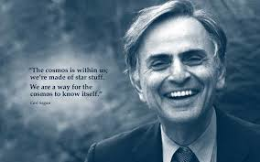
Now we are going to take a look at the second speech.
Carl Sagan speaking to an audience at the anniversary of the battle of Gettysburg on 9/13/1988.

Slide 10
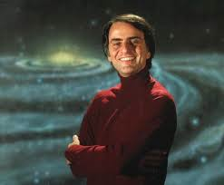
Who is Carl Sagan?
Famous scientist
Worked at Harvard and Cornell
Was an advisor to NASA
Writer and narrator for the series COSMOS, a show about the universe, which has been seen by over 500 million people.
Advocated science education and critical thinking.

Slide 11
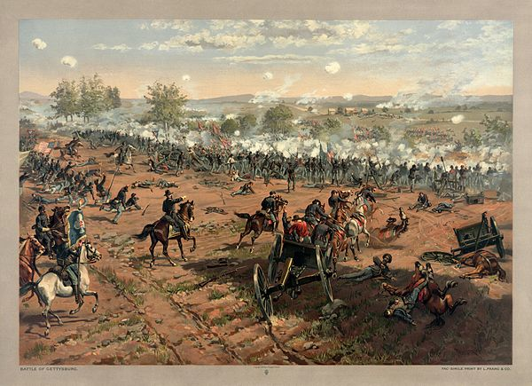
What do I need to know about the text?
The Battle of Gettysburg
World War II

Slide 12
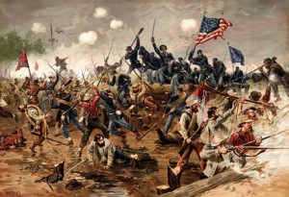
The Battle of Gettysburg
Union (northern) troops defeated Confederate troops led by General Lee.
Decisive victory for the North even though General Lee escaped.
Turning point for the war; before this Lee was considered “invincible.”
Fought with muzzle loading rifles, some new Springfield repeating rifles, cannons, and even bayonets (long blades on the end of the rifles)
About 620,000 total casualties

Slide 13
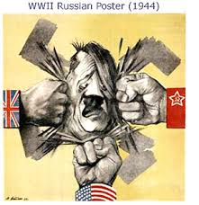
WORLD WAR II
Conflict between Allied (mainly UK, USSR, and US armies) and Axis Powers (mainly German, Italian, and Japanese armies)
Arguably, the first fully mechanized war.
Considerable use of tanks, vehicles, airplanes, etc.
Total Casualties range from between 50 and 80 Million people.
For comparison: there are currently about 318 million people in the US.
Sagan references a blockbuster bomb.

Slide 14
Challenges for Sagan
Humans are bad with abstractions.
Getting people to understand the destructive force of these weapons is difficult. How much more is a billion?
Try this: Can you explain the difference between a million and a billion in a way that is clear?
A million seconds is 13 days.
A billion seconds is 31 years.
Many people believe that war is a part of human nature and we have survived wars in the past.

Slide 15
Predict
Switch Teachers
Read Silently
Summarize
Evaluate the Prediction
Clarify
Question

Slide 16
Vocabulary
Precursor
Industrialized
Contending
Vigorously
Assertions

Slide 17
Precursor
DEFINITION: something related that comes before.
EXAMPLE: The Atari 2600 was the precursor to the Xbox One.
IN TEXT EXAMPLE: “That balloon was a precursor of the air forces and strategic bombing and reconnaissance satellites.”

Slide 18
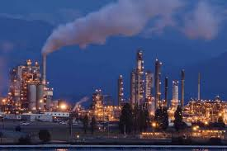
Industrialized
DEFINITION: making something industrial (made in factories)
EXAMPLE: The process of making knives was industrialized. The machines made knives hundred of times faster and cheaper than by hand.
IN TEXT EXAMPLE: “This was the first full-fledged example of and industrial war, with machine-made arms, and railroad transport of men and material.”

Slide 19
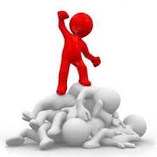
Contending
DEFINITION: struggling with.
EXAMPLE: The home team was contending with the opposing team and the bad weather.
IN TEXT EXAMPLE: “Even a small fraction of the strategic arsenals could, without question, annihilate the two contending super-powers, probably destroy global civilization, and possibly render the human species extinct.”

Slide 20
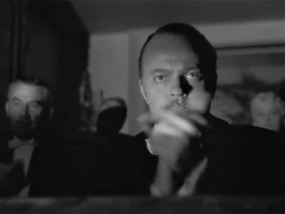
Vigorously
DEFINITION: doing with a great deal of energy.
EXAMPLE: He vigorously scrubbed the stain on his shirt until it was gone.
IN TEXT EXAMPLE: ”We initiated and vigorously pumped up an arms race with the Soviet Union.”

Slide 21
Assertions
DEFINITION: a confident statement or claim.
EXAMPLE: The phone company made several assertions about the reliability of the network.
IN TEXT EXAMPLE: In the preceding year, confident assertions, were made by officials of both nations that no accidents of that sort could occur.

Slide 22
AFTER READING
Now that we have taken a look at the works and the vocab. We are going to answer the following question.
Which speech is more constructed more effectively?
Keep in mind:
Audience
Purpose
Specific claims
Ethos (creating and maintaining)
Use of logos and pathos

