Slide 1
Bellringer: May 19
Have you ever found yourself laughing at a time where you should be upset? Share the story with your partner.

Slide 2
Laughing At the end of the world
Satire in film as social commentary

Slide 3
Satire
A genre of literature, and sometimes graphic and performing arts, in which vices, follies, abuses, and shortcomings are held up to ridicule, ideally with the intent of shaming individuals, corporations, government or society itself, into improvement.
Although satire is usually meant to be humorous, its greater purpose is often constructive social criticism, using wit as a weapon and as a tool to draw attention to both particular and wider issues in society.

Slide 4
Satire
A genre designed to critique some aspect human society
Can be different media like performing arts or literature
Uses humor and irony to deliver a message about some serious issues.
PARODY
Satire
Colbert Report
Simpsons
Huck Finn

Slide 5
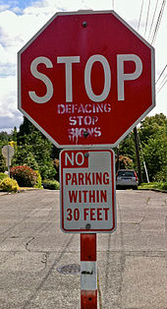
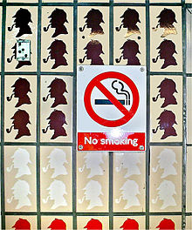
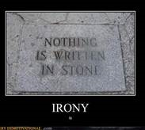
Irony and Satire: BFF
A feature of satire is strong irony or sarcasm
And in case you forgot, irony is a contrast of expectation of a situation and the reality.

Slide 6
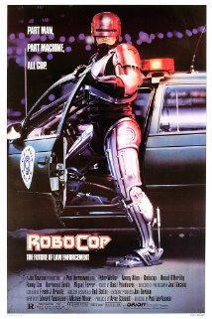
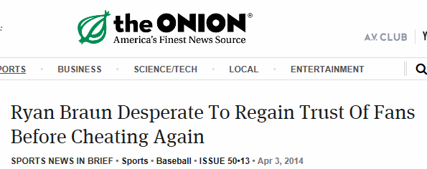
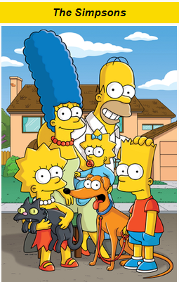
Popular Satires

Slide 7
Wait, Was that Robocop?
Yup, even an ultra-violent action movie can be a satire.
Parts of the movie are so over-the-top that they become clearly ironic.
One part of the film actually has Robocop “walk on water.” You know…like Jesus.
People have actually written academically about the social critique offered by a movie about a Robot Police Man who—at one point—stabs a man in the neck with a spike.
“While Robocop offers a vigorous critique of capitalism as an inhuman, ruthless, and corrupt society (as represented in the figures of Jones, Morton, and Boddicker), its critique is also directed against technology. In the paranoid, technophobic world of Robocop, technology is out-of-control. Throughout the film we see the human world trying to master nature but ultimately failing. Thus, the numerous failures of ED-209, the power failure at the SDI space station and its subsequent misfires, the return of Robocop's memory and former identity despite computerized programming -- all signal the film's critique of technological reification as a flawless cybernetic control over the human lifeworld, albeit one already integrated with technology. “

Slide 8
Why Satire?
Check the first slide again:
“its greater purpose is often constructive social criticism, using wit as a weapon and as a tool to draw attention to both particular and wider issues in society”
Oversimplification:
People will pay attention to what you are saying
because you do it in a clever, and/or humorous way.

Slide 9
Quick Check
Based on the criteria here:
Come up with an example of satire which already exists.
Think about the creator’s message – what is he poking fun at so that we’ll change?
Share with your partner.
Be able to explain why your partner’s answer is an example of satire.

Slide 10
Dr. Strangelove: or How I learned to stop worrying and love the bomb
First some historical terms you need to know.
WE HAVE ALREADY DISCUSSED SEVERAL OF THESE:
Cold War
Nuclear Weapons
Mutually Assured Destruction (MAD)
Missile Gap
Doomsday Machine
Fallout

Slide 11
Cold War
A war that is waged without open combat between two groups
A conflict between NATO (US and allies) and the Warsaw Pact (Soviet Union and its allies)
George Orwell, author of Animal Farm and 1984 helped popularize the term.
“Soldiers of the Soviet Union and the United States did not do battle directly during the Cold War. But the two superpowers continually antagonized each other through political maneuvering, military coalitions, espionage, propaganda, arms buildups, economic aid, and proxy wars between other nations.” – JFK Presidential Library and Museum

Slide 12
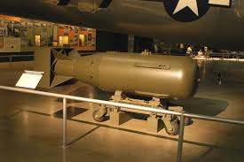
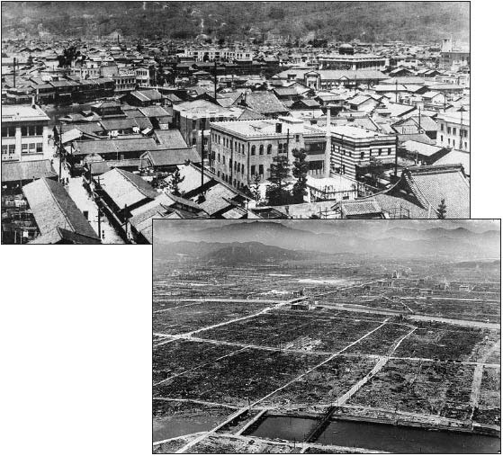
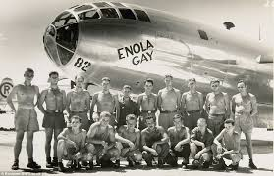
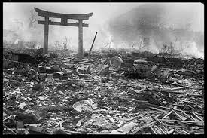
Nuclear Weapons

Slide 13
Fallout and Nuclear Winter
Nuclear weapons have a different effect than normal explosives. They are far more insidious.
Fallout is residual radioactive material propelled into the upper atmosphere following a nuclear blast or a nuclear reaction conducted in an unshielded facility, so called because it "falls out" of the sky after the explosion and shock wave have passed.
Can cause: immediate death, cancers, birth defects...
Nuclear winter-the theory that detonating a number of nukes could block out the light and cause severe climate change for years, disrupting the food chain.

Slide 14
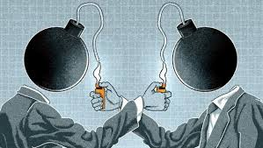
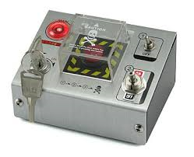
M.A.D. and the Doomsday Machine
Mutually Assured Destruction (MAD)-the idea that no side will begin a nuclear war because, in the event of a nuclear war, both sides will be completely destroyed regardless of who attacks first.
Doomsday Machine-a machine that could automatically bring about the end of human life. The idea is that no side would dare attack because the doomsday machine would kill everyone.

Slide 15
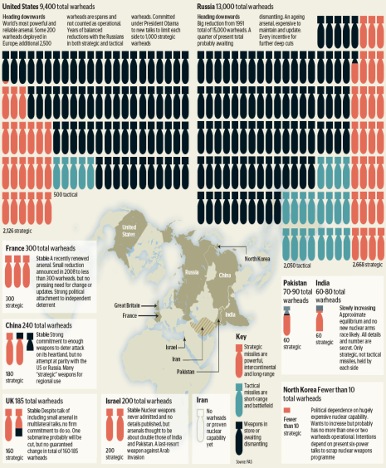
Arms Race/ Missile Gap
The ARMS RACE is the idea that one side shouldn’t get ahead in military capability
The missile gap was the Cold War term used in the US for the perceived superiority of the number and power of the USSR's missiles in comparison with its own.
Like the bomber gap of only a few years earlier, it was later demonstrated that the gap was known to be illusionary from the start, and was being used solely as a political tool, an example of policy by press release.

Slide 16
I’m depressed now. When does the laughing happen?
Because humans were finally looking at the possibility of the end of the world, American culture became obsessed with nuclear weapons.
Many wrote stories about living in a nuclear crisis. Many did so in order to get people to think about the immense danger we were living in.
Three famous novels: Alas, Babylon, Red Alert, and Fail Safe all deal with a nuclear crisis seriously.
Dr. Strangelove is based on Red Alert, but the director decided to highlight the absurdity or irrationality of the situation to highlight the dangers of nuclear war.

Slide 17
Summary
Based on our discussion, why might nuclear war be a good target for satire?
Jot down your response. Crumple it up and throw it at a classmate. Get a new response yourself.
Read and compare

Slide 18
What we are doing?
1. Watch Dr. Strangelove
2. Complete viewing guide (except the character chart)
3. Compare viewing guide with classmates to fill in holes
No, I’m not going back or waiting because you weren’t paying attention.
Notes:
Don’t go on to the next slide until after you view the film and answer the film reading questions.

Slide 19
Ticket Out May 19
Answer the question on the ticket out paper I gave you.
Be sure your name is on it.
It will be graded, so write with complete sentences and use some details which you explain.

