Slide 1
Bellringer: May 4, 2015 In YOUR NOTES
If you could, would you disable all of the nuclear weapons in the world?

Slide 2
To Nuke or to not to Nuke (part 1)
Looking at speeches that argue for and against spending on nuclear weaponry.

Slide 3
Persuasion or Argumentation? REVIEW!
With your partner, decide on what you think is the difference between persuasion and argumentation.
Hint – think of the difference between FAUBUS’s and KING’s texts.

Slide 4
Argumentation vs. Persuasion… in a nutshell
Argumentation:
1. For more academic audiences
2. Focus is almost entirely logical
3a. Recognizes all evidence surrounding an issue
3b. Makes a claim, but addresses evidence for the other side via counterarguments
Persuasion:
1. for less academic audiences
2. Appeals to the heart and the mind
3. Focuses almost entirely on one side
4. More common than argumentation (think commercials and election speeches)

Slide 5
Why review this now?
We will be reading two pieces about the American Arsenal, both conventional and nuclear.
Ronald Reagan's speech about defense spending and SDI
Carl Sagan’s speech at Gettysburg
The audience and format of the pieces control the level of argumentation versus persuasion.

Slide 6
Talking about them has common vocabulary which you must use in your analysis and in your discussion.
Rhetorical Devices
Ethos
Logos
Logical Fallacy
Pathos

Slide 7
First: Ethos Logos Pathos
review video!!!

Slide 8
Ethos
Sometimes internal:
Happens inside of the reader when understanding who is speaking. You are judging their credibility and believability based on their method of persuading you or how logical they are arguing their claim. If you sense that they are speaking with a hidden agenda or a skewing bias, their ethos is hurt.
Sometimes external:
Happens in a piece when an author mentions their qualifications. Their credentials transfer credibility and believability.
Belongs a bit more with persuasion
However, in both argumentation and persuasion, the validity and relevance of evidence depends on the reputation of the source.

Slide 9
Pathos
Manipulating emotions of the audience
How is the author making his audience feel in a way that will make them agree with his claim or his position?
Very effective for large/wide audiences
Particularly effective in speeches.

Slide 10
Logos
You use rational, coherent reasoning to create your point. This reasoning involves having a solid claim, relevant clear examples with specific explanations of how the examples connect to and prove the claim.
Fallacies: sometimes things that sound logical, aren’t in reality. Common errors in logic are called fallacies.
Most emotional appeals are actually fallacies.

Slide 11
Is this example better categorized as LOGOS or PATHOS? Explain.
“That budget is much more than a long list of numbers, for behind all the numbers lies America's ability to prevent the greatest of human tragedies and preserve our free way of life in a sometimes dangerous world.”

Slide 12
Reading Goals
We will use the reading guide to help analyze Reagan's speech. Your responses must be specific to the text. General and Vague answers are BAD!!
We are going to evaluate the effectiveness of his appeals and the reasoning behind them.
We will answer the question: Was Reagan's speech effective in convincing his audience to support his vision for the nation’s arsenal?

Slide 13
A little background on the piece
Reagan's speech was delivered on March 23rd 1983.
It was nationally televised (remember this was before cable was commonplace and, for most Americans, this was all that was on)
The US was just coming out of a recession and the budget was a major concern.

Slide 14
Some Important Terms
First some historical terms you need to know:
The Cold War
Nuclear Weapons
Mutually Assured Destruction (MAD)
Fallout
Missiles
ICBM (long-range)
IRBM (intermediate-range)

Slide 15
The Cold War
A war that is waged without open combat between two groups.
A conflict between NATO (US and allies) and the Warsaw Pact (Soviet Union and its allies)
Originated from the following quote: “…but few people have yet considered its ideological implications—that is, the kind of world-view, the kind of beliefs, and the social structure that would probably prevail in a state which was at once unconquerable and in a permanent state of "cold war" with its neighbors.” – George Orwell

Slide 16
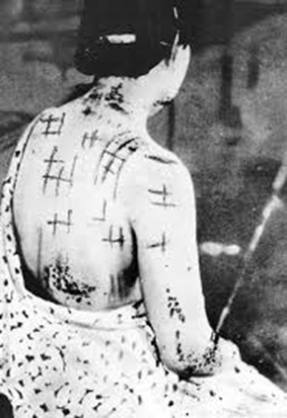
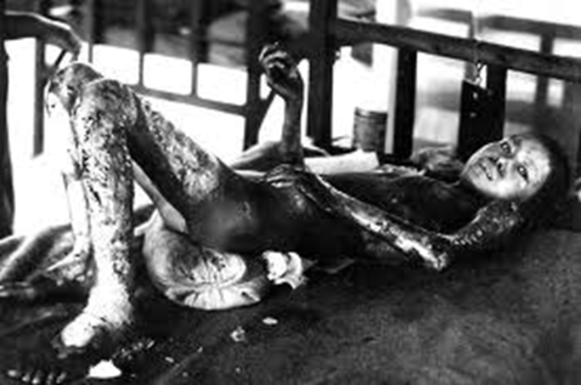
Nuclear Weapons
Survival Town: Atomic Testing (2:44 minutes)
Or Declassified film #55 - start around minute 9
For more video, try this link at home
Nuclear Bomb Tests (1955) Dummy Town (15 minutes)

Slide 17
Fallout and Nuclear Winter
Nuclear weapons have a different effect than normal explosives. They are far more insidious.
Fallout is residual radioactive material propelled into the upper atmosphere following a nuclear blast or a nuclear reaction conducted in an unshielded facility, so called because it "falls out" of the sky after the explosion and shock wave have passed.
Can cause: immediate death, cancers, birth defects...
Nuclear winter-the theory that detonating a number of nukes could block out the light and cause severe climate change for years, disrupting the food chain.

Slide 18
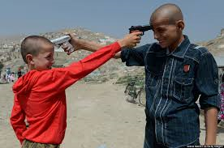
M.A.D.
Mutually Assured Destruction (MAD)-the idea that no side will begin a nuclear war because, in the event of a nuclear war, both sides will be completely destroyed regardless of who attacks first.

Slide 19
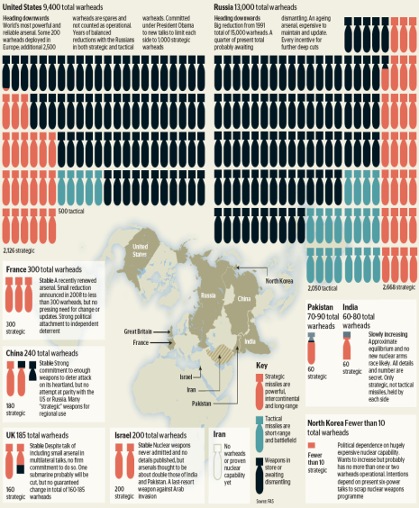
Arms Race/Missile Gap
The idea that one side shouldn’t get ahead in military capability
The missile gap was the cold war term used in the US for the perceived superiority of the number and power of the USSR's missiles in comparison with its own.

Slide 20
In your notes, explain how the Cold War, MAD, and the Arms Race/Missile Gap are connected. Share with your partner and be ready to share what your partner said.

Slide 21
A few historical events
Reagan specifically mentions a few events that you need to be aware of to understand why he included them.
The Cuban Missile Crisis
Polish Protests
Soviet Invasion of Afghanistan

Slide 22
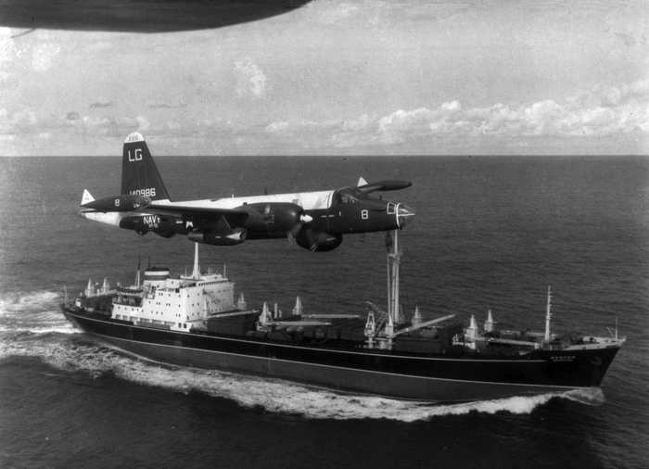
The Cuban Missile Crisis 1962
The US put nuclear missiles in Turkey and tried to overthrow Fidel Castro in Cuba
The USSR and Cuba agreed to install nukes in Cuba.
The US set up a blockade around Cuba and fired warning shots at Soviet vessels that tried to run the blockade.
We came very close to a military conflict with the USSR
President Kennedy and Premier Khrushchev reached an agreement.
USSR gave up the missile sites in Cuba
US dismantled its Jupiter missiles in Turkey and agreed not to invade Cuba

Slide 23
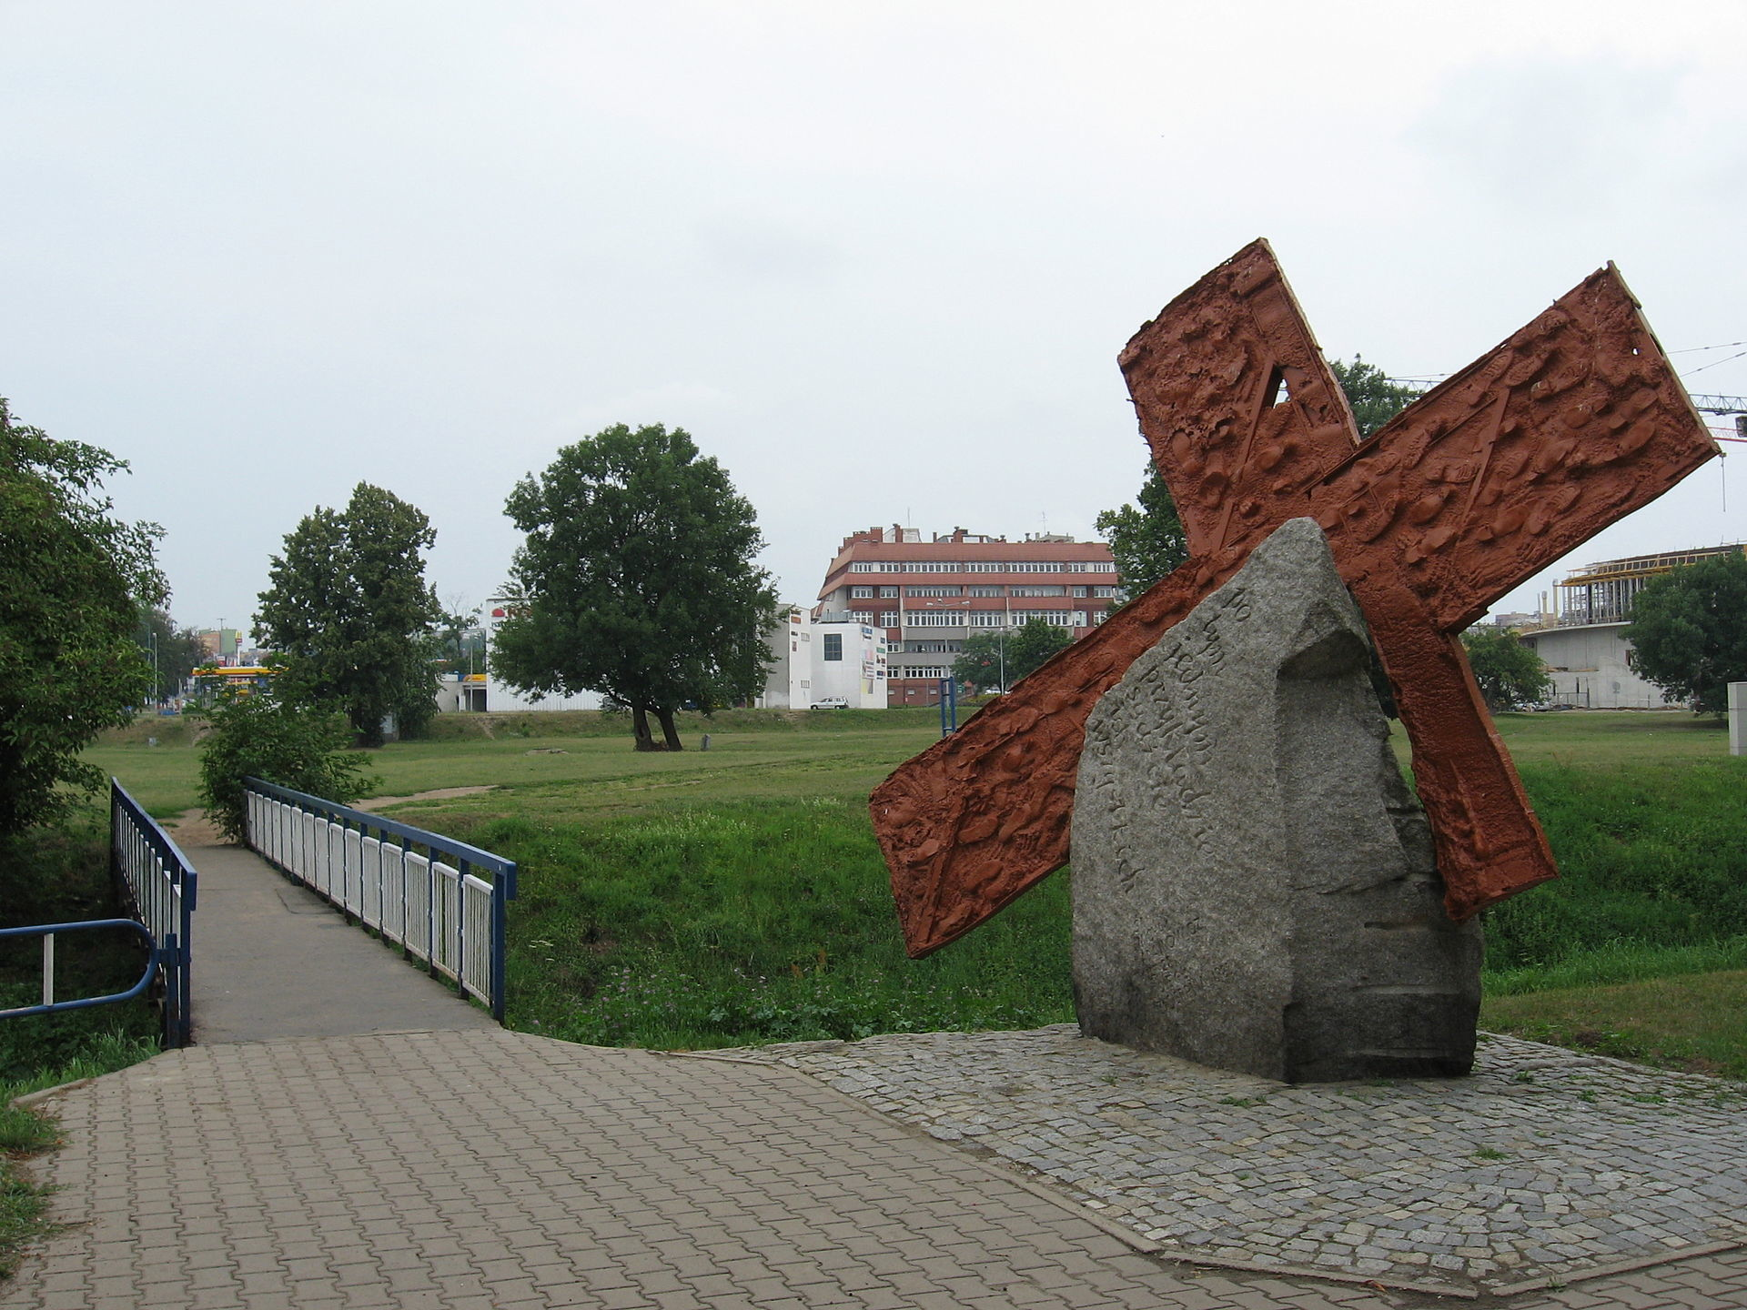
Polish Warning Strike in Poland and the Polish Demonstrations of 1982
1981-Members of a Polish trade union were brutally beaten by Soviet-backed security forces, so they organized an nationwide strike.
1982-Large protests resulted in the death of a few protesters when the same security forces opened fire.

Slide 24
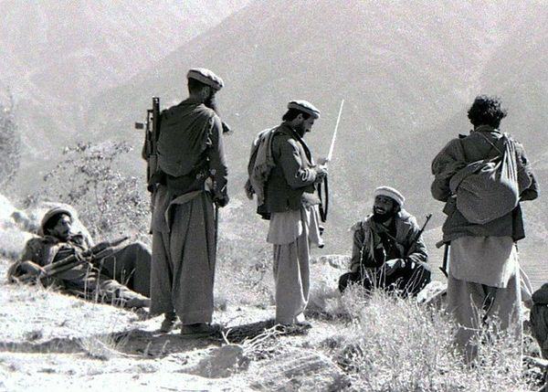
Soviet Invasion of Afghanistan 1979-1989
The Soviets invaded Afghanistan after its leader was killed in a Coup.
The invasion caused several insurgent groups (called the Mujahidin – “one who fights in a jihad”) to wage a guerilla war against the Soviet soldiers.
The US secretly supported the Mujahidin by providing weapons and funding.
This same group of Mujahidin later became the Taliban.

Slide 25
Who is Ronald Reagan?
40th president of the US
Governor of California for eight years.
Once a famous Hollywood actor
Created the War on Drugs
Big fan of cutting spending on social programs
Reduced regulation on the economy
Stepped up The Cold War to put increased pressure on the Soviet Union

Slide 26
Challenges for President Reagan
1. Humans are bad with abstractions.
He needs to explain what the big numbers and the percentages in the budget debate really mean
2. Nuclear war is terrifying and likely unwinnable.
3. Increasing spending on defense means
Deficit spending (spending more than the government takes in), which no one really likes
More taxes! Everyone loves that!
Cutting other programs that people like
4. Spending money on arms, in a best case scenario, means spending money on something that never gets used.

Slide 27
SUMMARY: 3-2-1 IN YOUR NOTES
List 3 other things you know about The Cold War.
List 2 ways Reagan may use the information about the Cold War.
Write down one question you have about the era.
Share your responses with your partner and be ready to share what your partner said with the class.

Slide 28
During Reading Instructions
1. You and your elbow partner are going to read the speech and complete the questions in the embedded reading guide.
2. You can vary your approach to this task, but:
You must each answer all of the questions! DO NOT SPLIT THE QUESTIONS!
Remember the point of this task is to learn how Reagan put together this speech, not to turn in a reading guide for points. I’m not grading notes!
If you only do part, you only learn part and your graded assignment will score low.
Feel free to discuss your answers with your partner. Talk through what you think about the speech.
The speech can be read aloud in about 30 minutes. You are expected to read page ____ today.

Slide 29
Checking what we read
Now that you have completed your reading guides, you and your partner are to find another pair of students to work with.
Share your responses.
If you disagree about some answers, talk it through.

Slide 30
Ticket out – May 4
On the paper provided, identify which rhetorical device Reagan seems to be using most effectively AT THIS POINT IN THE TEXT.
Record which page you read until.
Explain WHY you think this device is being used effectively. Go beyond regurgitating the definition of the device
HINT: Rhetorical Device –
ETHOS, LOGOS, PATHOS!!!~!!!!~!!~!@~#~!@

