Slide 1
Bellringer: May 5 IN YOUR NOTES
What emotion in his audience does Reagan seem to want? Explain.
“We can’t afford to believe that we will never be threatened. There have been two world wars in my lifetime. We didn’t start them and indeed, did everything we could to avoid being drawn into them. But we were ill-prepared for both. Had we been better prepared, peace might have been preserved.”

Slide 2
Vocabulary from the text you might need: Read the following definitions for some vocabulary help.

Slide 3
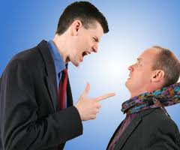
AGGRESSOR
DEFINITION: A person or country that attacks another first
EXAMPLE: The small girl was trying to be calm during the argument. It was clear that her brother was the aggressor.
IN TEXT EXAMPLE: “The defense policy of the United States is based on a simple premise: The United States does not start fights. We will never be an aggressor.”

Slide 4
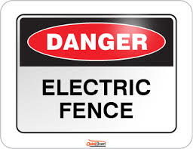
DETERRENCE
DEFINITION: the act of making someone decide not to do something
EXAMPLE: I buried some land mines as as an act of deterrence for the deer.
IN TEXT EXAMPLE: Deterrence means simply this: making sure any adversary who thinks about attacking the United States, or our allies, or our vital interests, concludes that the risks to him outweigh any potential gains.

Slide 5
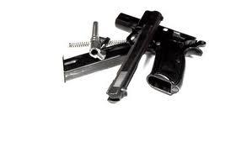
Dismantle
DEFINITION: To take apart and make ineffective.
EXAMPLE: I had to dismantle my sister’s saxophone in order to spare the rest of the family.
IN TEXT EXAMPLE: “We will begin that deployment late this year. At the same time, however, we're willing to cancel our program if the Soviets will dismantle theirs.”

Slide 6
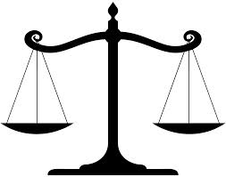
Offset
DEFINITION: something that balances the effect of something else
EXAMPLE: I ran an extra two miles to offset the calories from my extra dessert.
IN TEXT EXAMPLE: “There was a time when we were able to offset superior Soviet numbers with higher quality, but today they are building weapons as sophisticated and modern as our own.”

Slide 7
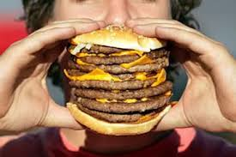
FORMIDABLE
DEFINITION: inspiring respect though being large, or powerful
EXAMPLE: The stable hand worked to handle the formidable waste from the new elephant.
IN TEXT EXAMPLE: “And now for the first time in history, the Soviet Navy is a force to be reckoned with in the South Pacific. Some people may still ask: Would the Soviets ever use their formidable military power?”

Slide 8
During Reading Instructions
1. You and your elbow partner are going to read the speech and complete the questions in the embedded reading guide.
2. You can vary your approach to this task, but:
You must each answer all of the questions! DO NOT SPLIT THE QUESTIONS!
Remember the point of this task is to learn how Reagan put together this speech, not to turn in a reading guide for points. I’m not grading notes!
If you only do part, you only learn part and your graded assignment will score low.
Feel free to discuss your answers with your partner. Talk through what you think about the speech.
The speech can be read aloud in about 30 minutes. You are expected to finish through page 7 today. We will start with page 8 next class.

Slide 9
Reading Check Instructions
When I give the command, you and your partner are to find another pair of students to work with.
Share your responses.
If you disagree about some answers, talk it through.

Slide 10
Ticket Out May 5: What is Reagan’s strongest reason in his speech for increasing defense spending. Explain why it is the strongest for convincing his nationwide audience.

Slide 11
Bellringer May 7: In your notes: What is the consistent emotion(s) which Reagan wants the American people to be feeling as they are listening to his speech. Find at least three different places in the speech (beginning, middle, and page 7) which demonstrate what you’re saying.

Slide 12
During Reading Instructions
1. You and your elbow partner are going to read the speech and complete the questions in the embedded reading guide.
2. You can vary your approach to this task, but:
You must each answer all of the questions! DO NOT SPLIT THE QUESTIONS!
Remember the point of this task is to learn how Reagan put together this speech, not to turn in a reading guide for points. I’m not grading notes!
If you only do part, you only learn part and your graded assignment will score low.
Feel free to discuss your answers with your partner. Talk through what you think about the speech.
The speech can be read aloud in about 30 minutes. You will finish pages 8 – 11 in 30 minutes. At that time we will write our response. You only have TODAY to write.

Slide 13
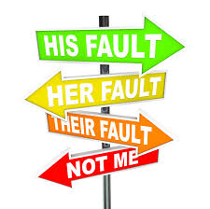
Scapegoat: a person who is unfairly blamed for something that others have done Example: The outfielder who dropped the ball became the scapegoat for the loss when really the entire team performed poorly. From the text: But we must not be misled by those who would make defense once again the scapegoat of the Federal budget.

Slide 14
ABM treaty : Treaty Between the USA and the Soviet Union (USSR) on limiting Anti-Ballistic Missile Systems
Anti-Ballistic Missiles are uses in defending areas against ballistic missile –delivered nuclear weapons. Under the terms of the treaty, each party was limited to two ABM complexes, each of which was to be limited to 100 anti-ballistic missiles . Signed in 1972, it was in force for the next 30 years. In the speech we are studying, Reagan is announcing his Strategic Defense Initiative, a research program into ballistic missile defense which would be “consistent with our obligations under the ABM Treaty".
The project was a blow to Yuri Andropov’s so-called "peace offensive". Andropov was the Soviet leader in 1983. Andropov said that "It is time they [Washington] stopped... search[ing] for the best ways of unleashing nuclear war... Engaging in this is not just irresponsible. It is insane".
Regardless of the opposition, Reagan gave every indication that SDI would not be used as a bargaining chip and that the United States would do all in its power to build the system.
⁻ Wikipedia
To read the official treaty – follow this link

Slide 15
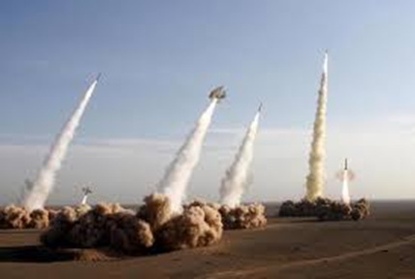
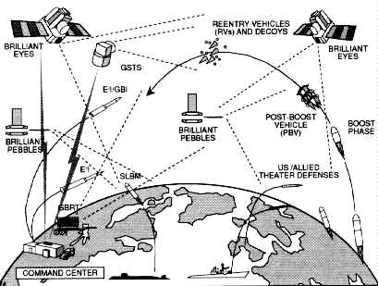
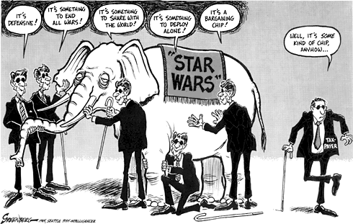
So what is Reagan announcing with this speech?
The Strategic Defense Initiative?
Spies Like Us clip to help explain SDI
The Soviets were threatened because the Americans might have been able to make a nuclear first strike possible. In The Nuclear Predicament, Beckman claims that one of the central goals of Soviet diplomacy was to terminate SDI.
A surprise attack from the Americans would destroy much of the Soviet ICBM fleet, allowing SDI to defeat a “ragged” Soviet retaliatory response. Furthermore, if the Soviets chose to enter this new arms race, they would further cripple their economy. The Soviets could not afford to ignore Reagan’s new endeavor, therefore their policy at the time was to enter negotiations with the Americans.

Slide 16
Writing Assignment
Answer the question:
Was Reagan’s speech effectively constructed to convince his audience to support his vision for the nation’s arsenal?
Use your reading guide to help guide your response.
USE literary vocabulary as you write as well.
Use the SCORING GUIDE to help!

Slide 17
Planning help – numbers refer to the pages that you might see the information on. Being in class when we made this diagram would have been best.

Slide 18
Ticket Out: May 7
This Ticket Out is graded.
Do you think Reagan’s speech is effective or not in convincing his audience?
Grade your in-class work today including focus and time on task. A =excellent focus. Good work done.
C = so-so focus. I just sort of did my work.
F = I was mostly off task, a real pain to those who were on-task.

