Slide 1
Bellringer: Nov. 10/12 You don’t need to write the questions. Write these in your notebook.
Why do you need to take tests to measure your reading and writing skills? Why does your teacher need these results? Why does the government needs these results?
Today’s agenda:
Take the SRI again. – we must do this first because I only have the cart for today.
Finish the Common Assessment. Yes, you have more time, but today is it. When you have finished the SRI, come see me to get your Common Assessment.
Work on the Unit Project – it is due next class (Thursday).

Slide 2
What is the SRI?
SRI stands for Scholastic Reading Inventory which tests how well you read at a fundamental level.
It takes less than 45 minutes.
The questions involve reading a short passage and answering a brief multiple choice question.
The test adapts to your answer to be more accurate.
This score will determine if you need an additional reading class or if you can come out of the one in which you are currently enrolled.
This test will be used multiple times to determine readiness for the next grade.

Slide 3
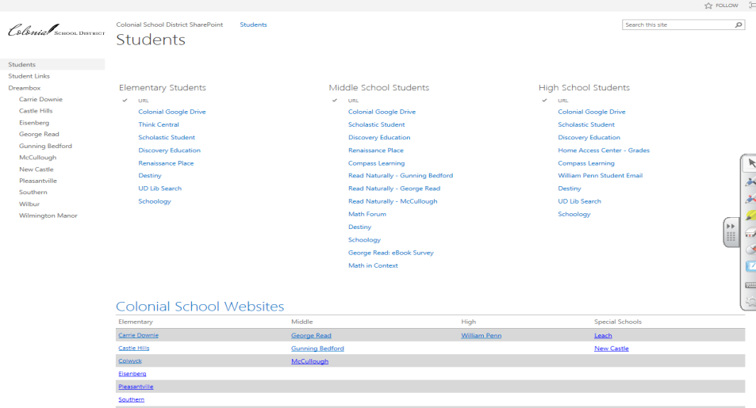
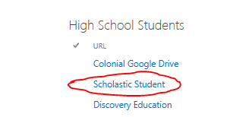
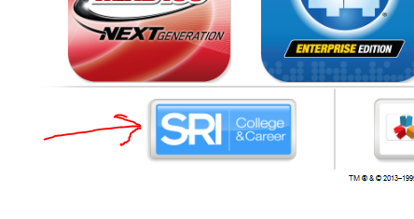
Log on to the computer.
Open up Internet Explorer (not Firefox, not Chrome)
You should see this.
On the new page:
Use the same login for the
computer:
Student Id # = username
8 digit birthday = password

Slide 4
Take the test!
When you are finished with the reading passages and questions, follow the directions.
After choosing the types of books you like best, click next and follow the directions.
When you are finished please let me know. You are to work on your common assessment and then your unit project.
I will not know if you went up or down until your score loads into the school’s data system.
DO NOT explore the internet or use your cell phone. We are testing. If you decide not to follow this directions, it will be considered defiance.

