Slide 1
BELLRINGER Oct. 6
Write the date and the question on a piece of lined paper to be turned in.
Why would you use a narrative to make a point to someone? How is a narrative different than an argumentative essay?
[Think about people who use narratives to teach a lesson or make a point (preachers, kindergarten teachers, parents, mentors…)]

Slide 2
Modes of Discourse: Nonfiction!
Narration - one might think of it as telling a story
Description - to describe something—object, person, place, experience, emotion, situation, etc. (the goal is to paint an image that is vivid and moving in the mind of the reader).
Exposition - to investigate an idea, evaluate evidence, expound on the idea, and set forth an argument concerning that idea in a clear and concise manner. (This can be accomplished through comparison and contrast, definition, example, the analysis of cause and effect, etc.)
Argumentation - to investigate a topic; collect, generate, and evaluate evidence; and establish a position on the topic in a concise manner. This writing is similar to “exposition,” but requires more extensive research.

Slide 3
Freakonomics
"What Makes a Perfect Parent?” (chapter 5 of Freakonomics)
How is this chapter organized?
“What Makes a Perfect Parent?”

Slide 4
Circle the 8 factors which you believe matter to a young child’s success in school
The child has highly educated parents.
The child’s family is intact.
The child’s parents have high socioeconomic status.
The child’s parents recently moved into a better neighborhood.
The child’s mother was thirty or older at the time of her first child’s birth.
The child’s mother didn’t work between birth and kindergarten.
The child had low birthrate.
The child attended Head Start.
The child’s parents speak English in the home.
The child’s parents regularly take him to museums.
The child is adopted.
The child is regularly spanked.
The child’s parents are involved in the PTA.
The child frequently watches television.
The child has many books in his home.
The child’s parents read to him nearly every day.

Slide 5
What’s this book about?!?
The book is a collection of 'economic' articles written by Levitt, an expert who has already gained a reputation for applying economic theory to diverse subjects. In Freakonomics, Levitt and Dubner argue that economics is, at root, the study of incentives.
The book's topics include:
Chapter 1: Discovering cheating as applied to teachers and sumo wrestlers, as well as a typical Washington DC area bagel business and its customers
Chapter 2: Information control as applied to the Ku Klux Klan and real-estate agents
Chapter 3: The economics of drug dealing, including the surprisingly low earnings and abject working conditions of crack cocaine dealers
Chapter 4: The role legalized abortion has played in reducing crime, contrasted with the policies and downfall of Romanian dictator Nicolae Ceauşescu
Chapter 5: The negligible effects of good parenting on education
Chapter 6: The socioeconomic patterns of naming children
--Wikipedia

Slide 6
Chapter 5: “What Makes a Perfect Parent?” Here’s the backstory…
The chapter begins by reviewing how parents get educated on raising their children and how parenting experts swing from one extreme to the next to “sell” their ideas.
parenting types
pro co-sleeping Vs anti co-sleeping
The authors considers what motivates parents to worry more about certain risks than others (swimming pools vs. guns) focusing on the effects of fear and misinterpretation of data.
how to sell using fear!

Slide 7
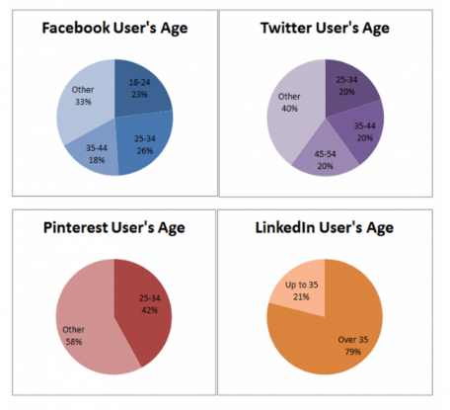
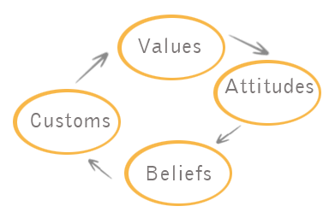
The chapter examines the influence of demographics, culture, and other variables that affect students’ performance on standardized tests.
?
SAT

Slide 8
Bottom Line
A successful child appears to be more “made” than nurtured.
(How is this similar to what we discovered with Outliers?)

Slide 9
Vocabulary!
ECLS:
Stands for Early Childhood Longitudinal Study. The project measures the academic progress of over 20,000 children from kindergarten through fifth grade with subjects that represent a cross section of American children. example
correlation:
A statistical term that indicates whether two variables move together.
Example:
cold & snow are positively correlated
Sun and rain are negatively correlated
what do these correlations look like?
regression analysis:
How an economist sorts huge piles of data to determine which factors are correlated and which are not.
It demonstrates correlation, but doesn’t prove cause.
why is it called regression?

Slide 10
Vocabulary in Context
Traction
Correlate
Jibes
Detrimental
Un/enlightened
Fervent
Conundrum
Socioeconomic Status
Conventionally
Congenitally

Slide 11
Read the text.
As you read, keep track of whether or not you were correct about your predictions (from the circle eight activity).
Your explanations for why you were correct or incorrect must include information from the text. Use specific details.

Slide 12
Ticket out –
Which of the four modes of discourse does Freakonomics chapter 5 seem to use:
Narrative
Description
Exposition
Argumentation?
Write this at the top of your reading guide.

Slide 13
Modes of Discourse: Nonfiction!
Narration - one might think of it as telling a story
Description - to describe something—object, person, place, experience, emotion, situation, etc. (the goal is to paint an image that is vivid and moving in the mind of the reader).
Exposition - to investigate an idea, evaluate evidence, expound on the idea, and set forth an argument concerning that idea in a clear and concise manner. (This can be accomplished through comparison and contrast, definition, example, the analysis of cause and effect, etc.)
Argumentation - to investigate a topic; collect, generate, and evaluate evidence; and establish a position on the topic in a concise manner. This writing is similar to “exposition,” but requires more extensive research.

Slide 14
Bellringer: Oct 2
On your list of 16 factors for Freakonomics, label each factor with one of the following symbols:
AB – does this factor deal with a kid’s ability
OPP – does this factor deal with a kid’s opportunities
AA – does this factor seem to be a possible arbitrary advantage
For example:
“Highly educated parents” might be labeled AB or AA depending on how you justify your response.
“Intact Family” might be labeled AA or OPP, again depending on how you justify your response.
YOU pick ONE LABEL for each of the 16. It’s YOUR opinion.

Slide 15
Previously: Freakonomics chapter 5: “What Makes a Perfect Parent?”
You began reading and predicting about why certain factors mattered and didn’t matter to a child’s performance in school.

Slide 16
Remember – this information is for EARLY Childhood performance. Re-read their point about academic performance later on in life.

Slide 17
Compare!
Find the eight factors that do matter for a child’s performance in the reading and draw a box around them.
Decide in your partnership – What do these factors have in common?
Find what the authors say they have in common. Explain what they mean.

Slide 18
Compare!
Find the eight factors that do not matter for a child’s performance in the reading and draw a box around them.
Decide in your partnership – What do these factors have in common?
Find what the authors say they have in common. Explain what they mean.

Slide 19
Contrast!
What is the major difference between the
factors that do matter and that don’t matter?
Why would the authors use a comparison/
contrast structure to show this difference?
CLAIM! – what seems to be their implied claim
or point to showing us this information?

Slide 20
Now ANSWER this question in a well formed paragraph.
How is the claim developed in "What Makes a Perfect Parent?”
Make sure you identify the claim.
Make sure you identify how the claim is developed.
Make sure you prove that the claim is the claim and that the text structure is the actual text structure.
Make sure you give and explain specific examples from throughout the chapter. FOUR should be adequate. Anything less and you haven’t proven your point.

Slide 21
Now – find eight factors (either that matter or don’t) and apply them to your own life.
Child was spanked – doesn’t matter to early childhood test scores. I scored well in tests as a child and I was spanked. The discipline didn’t have an impact on me in school other than I knew not to misbehave and to listen to the teacher. I knew that deliberate disobedience at school or home would result in punishment at home. So I didn’t act up and I wasn’t disrespectful.

Slide 22
Unit Project Drafting
Lesson 2 - Letters H-M:
You must have:
1 - narrative entry which tells the story of the hobby or sport in which you have put in the most hours. (Ability?)
1 - narrative entry in which you describe an opportunity which you jumped on or maybe didn’t and wished you had. (opportunity)
1 - narrative entry about a time in your life when something lucky happened. Keep it school appropriate. (perhaps an Arbitrary Advantage?)
3 - entries which each focus on a different factor discussed in Freakonomics. Compare and contrast your opinion with the authors’ opinion on why this factor does or does not matter for success. These are NOT narratives but are exposition.

