Slide 1
Bellringer Jan. 9 (odd) (Jan. 6 even)
Write the date, the question, and your response.
How do you plan for someone who you know is unreliable? (Like a friend who is always late or always saying they’ll pay you back and don’t?)
HEADS UP: You owe me from before break – the response from the movie and the response about evaluating the effectiveness of the facebook article’s claim.
Your projects are not due yet – we haven’t gone over how to put the information together.

Slide 2
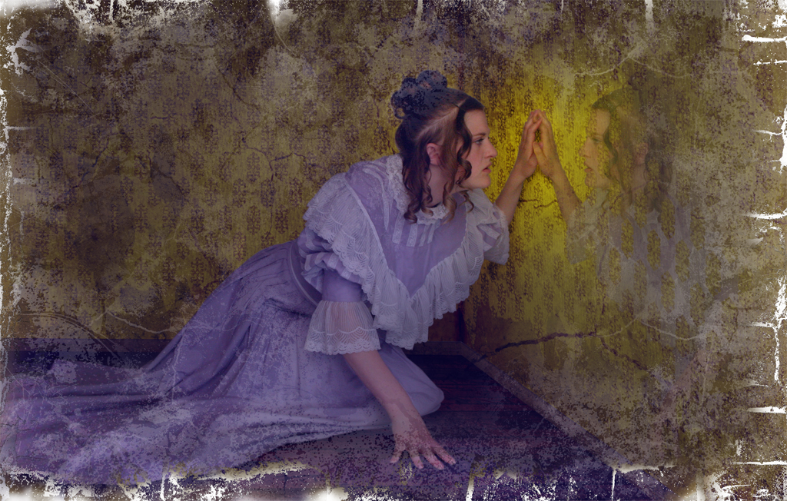
The Yellow Wallpaper
Ghost Story or Descent into Madness?

Slide 3
THE VICTORIAN ERA
-Industrialization brought with it a growing middle class whose increase in numbers had a significant effect on the social strata itself: cultural norms, lifestyle, values and morality.
-The concept of "privacy" became a hallmark of the middle class life.
-During the Victorian era, science grew into the discipline it is today. In addition to the increasing professionalism of university science, many Victorian gentlemen devoted their time to the study of natural history.
-There was a gothic revival in literature and architecture.

Slide 4
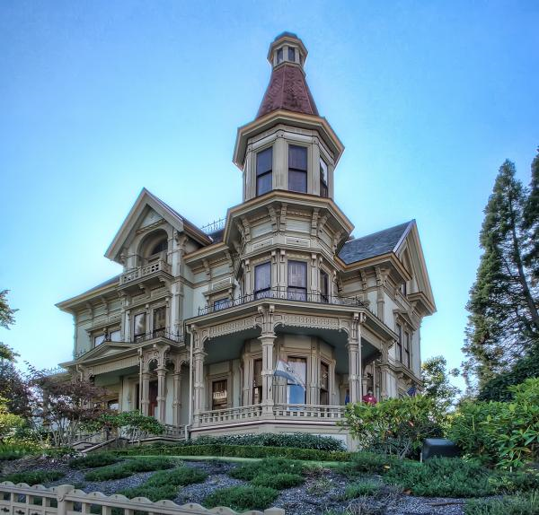
A Victorian house…

Slide 5
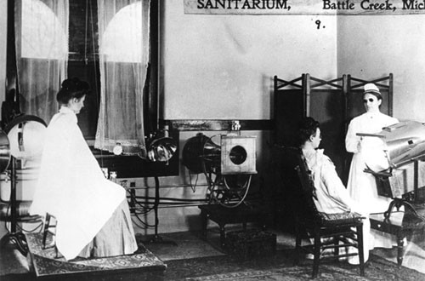
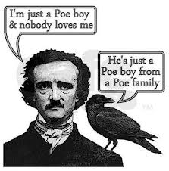
Weird ideas about health: the same basic era as Kellogg’s Sanitarium (yes, the cereal guy)
Poe is a solid representation of Victorian Gothic Fiction

Slide 6
The Rest Cure
As a remedy, neurologist S. Weir Mitchell, a wealthy and influential Philadelphia neurologist, created the rest cure, a regimen of forced bed rest, restricted diet, and a combination of massage and electrical muscle stimulation in place of exercise. Mitchell, author of “Wear and Tear; or, Hints for the Overworked” (1871), was known for treating “hysterics” (mostly women) and earned the scorn of feminists.

Slide 7
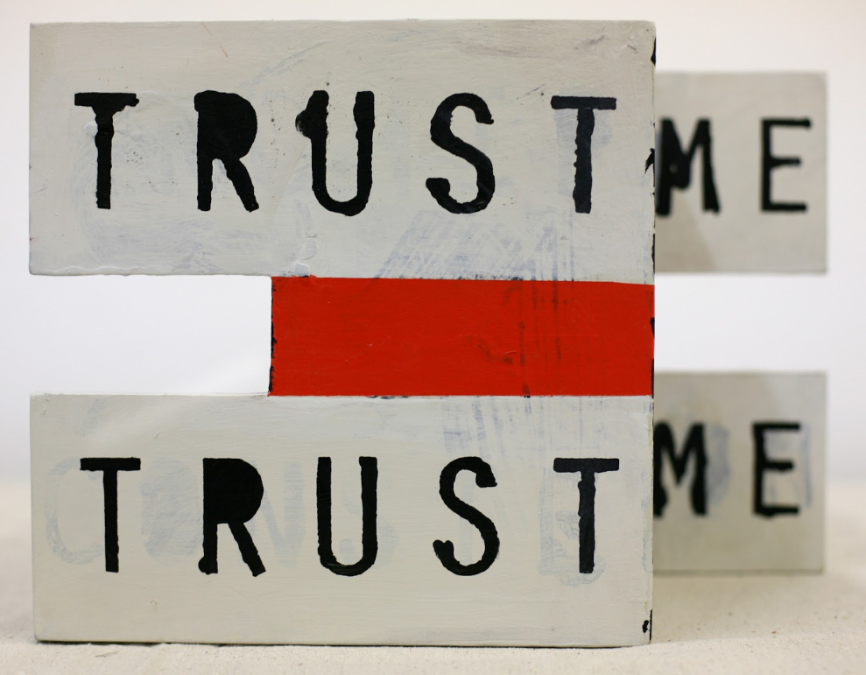
The Unreliable Narrator: a first-person narrator of a story who is inconsistent or untrustworthy in delivering the events of the story for various reasons

Slide 8
Done through characterization
Mostly what the narrator says and thinks
You need to look carefully at the word choice used.
You also need to keep an eye out for conflicts between what they say, think, and do to figure out how they unreliable

Slide 9
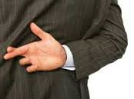
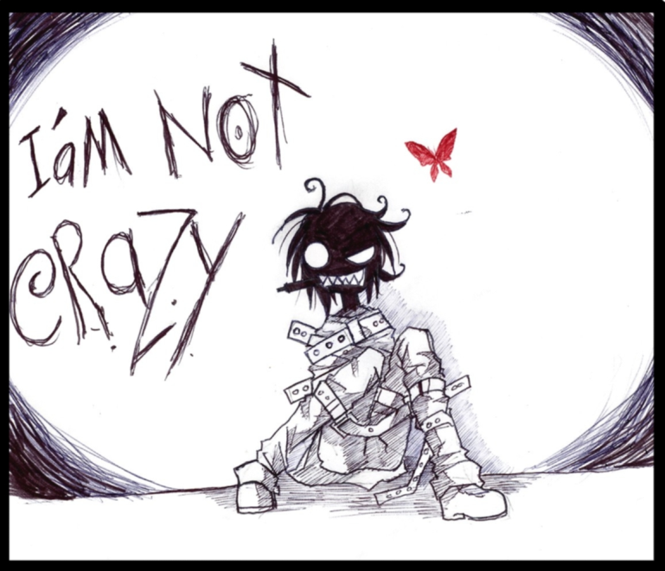
Sometimes narrators want you to believe their side of story
Sometime they are just not able to see the truth

Slide 10
How do you know if a narrator is unreliable?
Their information is contradictory. They say things that make other things they say untrue.
Their word choice doesn’t seem to match what they say is happening.
Their word choice is inconsistent in tone.
They gradually stop making much sense or start saying random things out of the blue

Slide 11
Why create an unreliable narrator?
An unreliable narrator can add a nice layer of complexity
  Mystery-The reader needs to figure out what is REALLY happening from subtle clues
  Suspense/tension-it is a great way to show a serious internal conflict honestly and make you worry about the mental state of the character
  Surprise-the narrator’s secrets can be revealed for a dramatic twist
  Theme-the author is able to make a point through the information that the narrator does and doesn’t share and what we infer about the character

Slide 12
Summary
Create a sentence using the following words to explain the relationship between the terms
  Unreliable narrator
  Word choice
  Tone
  Motivation
  Mystery
  Tension
  Surprise
  Theme

Slide 13
Reciprocal Teaching
We are going to read “The Yellow Wallpaper” using reciprocal teaching. The sections are marked on the text. Remember to record any details that may indicate the narrators degree of unreliability and what effect it has on the story.

Slide 14
How do we do Reciprocal Teaching?
FOLLOW THESE GUIDELINES!
Good question!

Slide 15
Bellringer: Jan 8
Write the date, the question, and your response.
When you aren’t feeling well, how do you like for people to treat you?`

Slide 16
Ticket Out (after Day 2 of reading)
3 – contradictions from the text
2 – events which have occurred during the story
1 – a possible theme the author could be developing.

Slide 17
NOW WRITE! WRITE AS IF YOUR LIVES DEPEND ON IT!
Answer LEQ: How does Charlotte Perkins Gilman in “The Yellow Wallpaper” stretch the bounds of reality using the perceptions of an unreliable narrator?
Assignment: CSET response
This response will need more than one or two examples to fully explain.

