Slide 1
Welcome!
English 10 students!

Slide 2
Who am I?
Mrs. Bowe, an eighteen year veteran of William Penn. That’s right, I was here before many of you were born.
I have taught 9, 10, 11, and 12th through those years.
I graduated from University of Delaware.
Before that I graduated from West Chester East.
Before that was so long ago, that I’d rather not think about it.

Slide 3
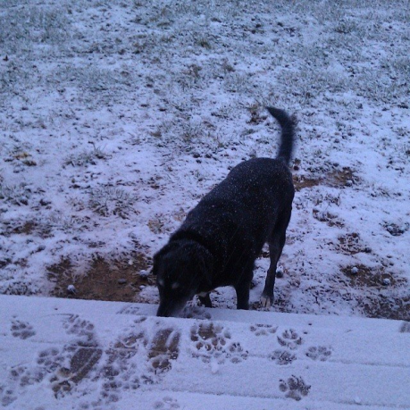
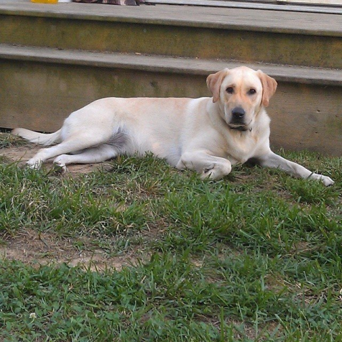
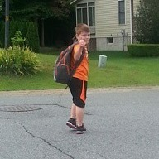
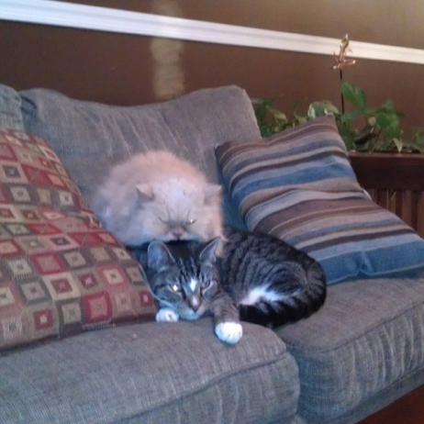
What else?
I have two dogs and two cats.
I have an 8 year old son (this is the first day of 3rd grade!)
I ran in the Run or Dye 5K this summer in Dover.

Slide 4
Course Description/Grading Policy
Here it is. Pay attention to the bold face type.
Note what a zero means for the online grade book.
Zeroes don’t need to stay zeroes. YOU can change them by submitting the assignment within the TWO week “late” assignment window. You won’t get full credit, but you’ll get most. If the assignment has already been returned, you’ll need to see me about the alternative assignment.
If you don’t have your summer reading assignment done by today, you have until Sept 5th. You will see a zero in the grade book for the assignment, BUT, you will receive full credit until Sept. 5th. After that, you’ll receive credit but with a late penalty applied. If you are a new enrollee, you need to get started, but I will set individual due dates with you.
SIGNATURE PAGES for the course description are due: Sept. __________________

Slide 5
What is happening this year?
You are in for the journey of your life!
Unit 1 – Knowing yourself
Unit 2 – Knowing the world
Unit 3 – Knowing intolerance
Unit 4 – Knowing our fate

Slide 6
You too will learn to be credible!
Remember CSET from 9th grade?

Slide 7
Reading!
Oh the things you will read!
Ask me about the extra credit assignment. I dare you.
Extra credit - Sell This Book Sept 2014!
Ask me about the classroom books around the room.
(yes, you may borrow them so long as you sign them out with me. Don’t be a book thief!)

Slide 8
WRITING!
Don’t be silent – you will be writing. A lot. In all your classes.
Work with me on this one.

Slide 9
Internet?
We’re in a red zone currently, BUT – you are required to go check out my weebly site.
wpboweela.weebly.com
http://wpboweela.weebly.com
We’ll have all sorts of information up.
You also need to register for the online textbook – who wants to carry around an extra 7.5 pounds. Please!
www.classzone.com – activation code = 4445780 - 260

Slide 10
Vignette Assignment
Who are you?
Think of the one word you would use to answer that question.
Don’t call it out.
Write it on the BACK of your name tent.
Be ready to share.

Slide 11
Homework
Course Description signature sheet – due ___Odd periods – Sept 3/Even periods Sept 4________
Vignette draft due: __Odd periods August 28/ Even Periods Sept 2_________
Summer Reading essay due: No later than Sept. 5th (after that you will get late penalties applied)
Extra Credit assignment due: Last day of class in September.
(In October, we begin a different reading project. Woot! Woot!!)

