Slide 1
Bellringer April 24
What message about humanity does Vonnegut seem to be saying in his short story?

Slide 2
Answer these questions in YOUR NOTES!!!!!
  What passage best captures Gramps personality? Why?
  If you were in Gramp’s position, would you act any differently?
  What are the top two examples of irony in the text?
  Pick a word that best describes what this story is about.

Slide 3
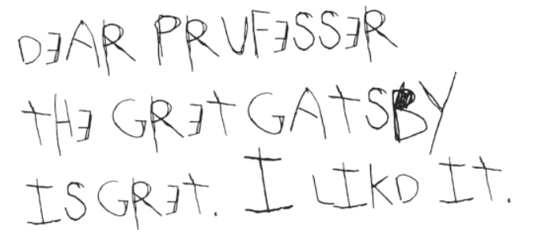
Write
We are now going to answer the lesson question using the information we just processed with the questions.
  How does Vonnegut create his theme about technology and human nature in “Tomorrow and Tomorrow and Tomorrow”?
    Think about our four questions:
      Technology and its effects
      Characterization of gramps
      The use of irony
      The most important word
Remember to use your new words!

