Slide 1
BELLRINGER
Find your seat. It will be different from DAY1.
Don’t move your seat. I have them written down.
Take out your vignette and write the word count at the top of the page.
Put a box around the most important sentence in the vignette.
If you don’t have your vignette draft, you are completing an “Oh no!” missing assignment paper and giving it to me.

Slide 2
Unit 1:
Knowing Yourself
Moving towards Maturity

Slide 3
Vignette assignment
Write a 100 words or less story about a specific moment in your life where you learned something about life or yourself.
It must have a short plot.
It must use imagery.
It must have specific and descriptive words.

Slide 4
Modes of Discourse
What is that?
A Mode of Discourse is a fancy way to describe how an argument is organized. You might remember this as pattern of organization.
A Vignette is a Narrative Mode of Discourse
A Comparison/Contrast is a different MOD.

Slide 5
Imagery
Listen and watch the following video:
Imagery Song
Partner 1: Summarize the main point to the song
Partner 2: Be prepared to share what your partner said.
Still confused? Try this video at home: More on Imagery

Slide 6
Specific Word Choice
Watch the video: Improving Word Choice
Partner 2: what are TWO recommendations for improving word choice
Partner 1: Be prepared to share out the two recommendations.
Do you need more help? Try this video at home:11 year old on specific word choice

Slide 7
Revising for imagery and word choice
Try it out:
1. change “got to”
2. change “car”
1. change “food”
2. change “play” (verb)

Slide 8
Write a couple sentences describing the scene in the picture.
Remember to use
IMAGERY!

Slide 9
Try it! Replace the vague words
1. “We got to the border”
2. “I was happy when I landed in New York”
1. “He helped me with my homework”
2. “We were there doing crazy things”

Slide 10
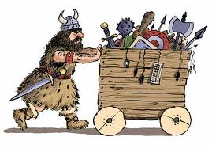
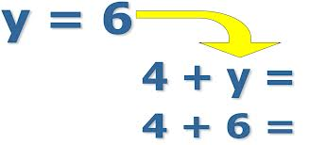
Revising Your Writing
A - Add information
and descriptions
R - remove stuff
M - move ideas for
the most effective
organization
S - Substitute specific
words for vague stuff
A | R
M | S

Slide 11
STOP!
Find places in your vignette draft to
ADD imagery
Remove something vague or unnecessary
Move something around
Substitute a vague word for a more specific one.

Slide 12
Take a look at the sample vignettes.
Partner 1: Decide what the message is for the vignette.
Partner 2: Identify a good example of imagery or word choice
Be prepared to share your partner’s example.
(Period 7 didn’t do this activity due to time)
Notes:
Laminated copies in drawer in w202.

Slide 13
Mrs. Bowe’s Draft
An early summer breeze fanned my arms and legs. Birds twittered and played tag in the nearby red plum tree. I could have gone inside to read this most recent fluff novel but the computer, email, phone messages, laundry, dusting, vacuuming, and dishes waited for me. If I saw them, I would have to attend to them. Just a couple more pages until I go back to my summer job – housekeeping.
(word count – 71)
Notes:
Period 2 TAM stopped here. Period 4 stopped here.

Slide 14
Four types of sentences (Refresher)
Simple (one subject and one verb)
Compound
Complex
Compound-Complex
Notes:
Chau has an activity with poetry tiles -

Slide 15
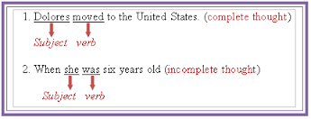
Dependent and Independent Clauses

Slide 16
Conjunctions (for more help with conjunctions: conjunctions! )
Coordinating - these join equals (FANBOYS)
Subordinating - these create COMPLEX sentences and destroy independent clauses.
after | since | when
although | so that | whenever
as | supposing | where
because | than | whereas
before | that | wherever
but that | though | whether
if | though | which
in order that | till | while
lest | unless | who
no matter | until | why
how | what | even though

Slide 17
Stop!
Check your drafts.
Do you have a variety of sentence types?

Slide 18
Showing your reader engages them!
Convey the message of who you are.
If you have only 100 words to give that message, every word counts.
Be specific and appeal to the reader’s senses using imagery.
Notes:
Period 1 Honors stopped here

Slide 19
DUE NEXT CLASS
You will revise your vignette rough draft.
You will turn in the following in this order:
1. Final “good” copy
2. rough draft with revisions
3. Direction page.

