Slide 1
Bellringer: Jan. 8 Online Survey -
All English classes have been asked to participate in an online survey.
This survey is optional. If you choose not to do it, return the paper packet to me.
Completing the TOTALLY ANONYMOUS survey will enter you into a drawing for a $50.00 Visa gift
The Link is on my webpage: http://wpboweela.weebly.com

Slide 2
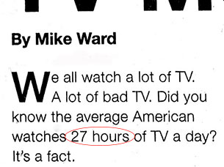
Logical Fallacies (CONT):
Testimonial—persuading by invoking support from respected individuals—athletes, movie stars, doctors—or institutions
Repetition—persuading through repeating the same image, word, symbol or phrase over and over
Ex: broadcasting the same commercial at each commercial break
Hyperbole— exaggerated claim

Slide 3
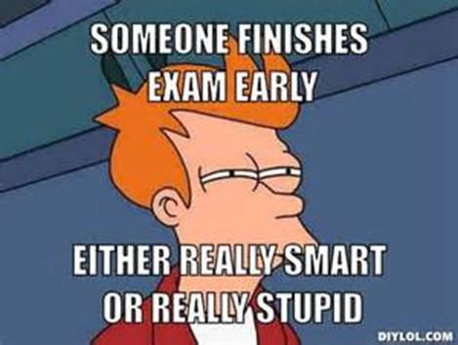
LOGICAL FALLACIES (cont):
Either/Or—a claim that there are only two choices when there are more. Used constantly by the media
Stacking the deck/Card stacking—taking information out of context or not providing the whole story
Ex: Gamblers 'stack the deck' in their favor by arranging the cards so that they will win. Writers 'stack the deck' by ignoring any evidence or arguments that don't support their position. I once experienced 'stacking the deck' when I went to buy a used car. The man trying to sell me the car talked only about how wonderful the car was. After I bought the car, another man tried to sell me an extended warranty by pointing out all the things that could break down." (Gary Layne Hatch, Arguing in Communities. Mayfield, 1996

Slide 4
LOGICAL FALLACIES (CONT):
Hasty Generalization – a generalization based on too little evidence
Ex: My father smoked four packs of cigarettes a day since age fourteen and lived until age sixty-nine. Therefore, smoking really can’t be that bad for you.
Oversimplification—offering a simple solution to an extremely complex problem

Slide 5
LOGICAL FALLACIES (CONT):
Red Herring – something that misleads or distracts from a relevant or important issue

Slide 6
Film as persuasion
What effects does the film maker use to guide the audience?
How does she transition from one topic to another?
What images are repeated over and over?

Slide 7
How does this Short video persuade?
SeaWorld Cares

Slide 8
While Viewing the film
All bags must be off your desk.
Phones are either stowed or placed FACE DOWN on your desk in plain site.
Notes are out and pen or pencil is on your desk.
You are seated upright – do not slouch or put your head down on the desk.
You are not talking except when we stop to talk.

Slide 9
BLackFisH
The Film is available on Netflix streaming or for rent on Amazon.com
Notes:
Period 2 stopped at minute 14:49

Slide 10
Ticket out
On the scrap paper provided, summarize what we know so far about the film. Include the main idea or purpose if you can.

