Slide 1
How little details and subtle implications show us about the world and others
“A Rose for Emily”
By William Faulkner
Notes:
Looking at little differences – leading into subtle details and implications

Slide 2
What do you notice?
Notes:
Starfish, mirror, hand, anchor, lamp,

Slide 3
What do you notice #2
Notes:
Phone pole, window, birds, stroller bar, snake color,

Slide 4
What can you infer based off of details?
http://www.youtube.com/watch?v=cRXNNqNfQBs
*Disclaimer* This scene from Men in Black has mild profanity. It’s not nearly as bad as what you hear in the hallways, though. ☺

Slide 5
Your turn!
Write a brief character description or draw a character. Include little details that show something specific about the character that might be overlooked.

Slide 6
STORY VOCABULARY!

Slide 7
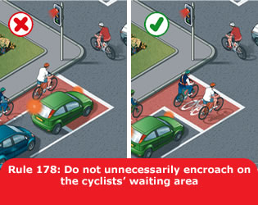
Encroach

Slide 8
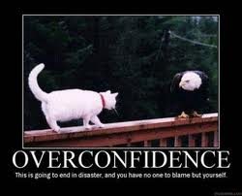
Temerity

Slide 9
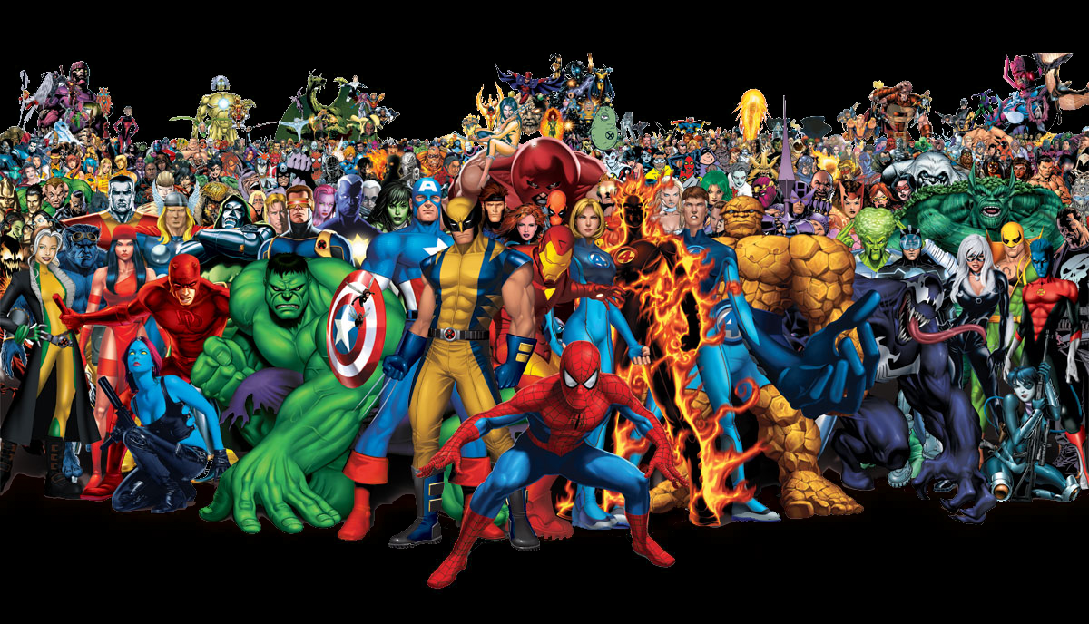
Cabal
Notes:
Cah-BALL

Slide 10
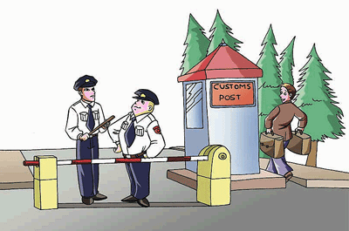
Circumvent

Slide 11
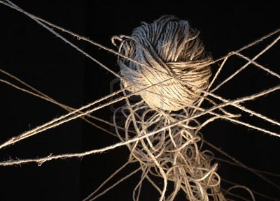
Inextricable

Slide 12
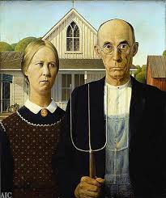
Tableau

Slide 13
Virulent

Slide 14
Pd. 8

Slide 15
Oops! Pd 1

Slide 16
Pd 3

Slide 17
Period 4

Slide 18
Pd 5

Slide 19
Reading the text
Read the story and answer the questions on the worksheet.
After your worksheet is totally answered, fill in the chart below in your notes.
Detail/Implication | Positive/Negative view | What’s it saying about the world/others?
Notes:
Reading guide for questions – distributive summaries worked into reading guide. Choose partners or not based on classes.

Slide 20
Assessment!!!
You are taking a test.
The first part is CLOSED NOTES/BOOK.
The second part for short answers/essay is open note/book.

