Slide 1
Bellringer: May 5 IN YOUR NOTES
What emotion in his audience does Reagan seem to want? Explain.
“We can’t afford to believe that we will never be threatened. There have been two world wars in my lifetime. We didn’t start them and indeed, did everything we could to avoid being drawn into them. But we were ill-prepared for both. Had we been better prepared, peace might have been preserved.”

Slide 2
Vocabulary from the text you might need: Read the following definitions for some vocabulary help.

Slide 3
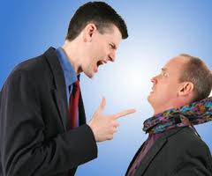
AGGRESSOR
DEFINITION: A person or country that attacks another first
EXAMPLE: The small girl was trying to be calm during the argument. It was clear that her brother was the aggressor.
IN TEXT EXAMPLE: “The defense policy of the United States is based on a simple premise: The United States does not start fights. We will never be an aggressor.”

Slide 4
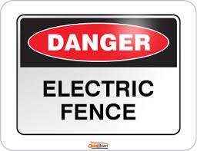
DETERRENCE
DEFINITION: the act of making someone decide not to do something
EXAMPLE: I buried some land mines as as an act of deterrence for the deer.
IN TEXT EXAMPLE: Deterrence means simply this: making sure any adversary who thinks about attacking the United States, or our allies, or our vital interests, concludes that the risks to him outweigh any potential gains.

Slide 5
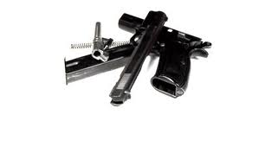
Dismantle
DEFINITION: To take apart and make ineffective.
EXAMPLE: I had to dismantle my sister’s saxophone in order to spare the rest of the family.
IN TEXT EXAMPLE: “We will begin that deployment late this year. At the same time, however, we're willing to cancel our program if the Soviets will dismantle theirs.”

Slide 6
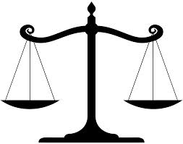
Offset
DEFINITION: something that balances the effect of something else
EXAMPLE: I ran an extra two miles to offset the calories from my extra dessert.
IN TEXT EXAMPLE: “There was a time when we were able to offset superior Soviet numbers with higher quality, but today they are building weapons as sophisticated and modern as our own.”

Slide 7
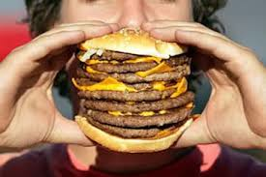
FORMIDABLE
DEFINITION: inspiring respect though being large, or powerful
EXAMPLE: The stable hand worked to handle the formidable waste from the new elephant.
IN TEXT EXAMPLE: “And now for the first time in history, the Soviet Navy is a force to be reckoned with in the South Pacific. Some people may still ask: Would the Soviets ever use their formidable military power?”

Slide 8
During Reading Instructions
1. You and your elbow partner are going to read the speech and complete the questions in the embedded reading guide.
2. You can vary your approach to this task, but:
You must each answer all of the questions! DO NOT SPLIT THE QUESTIONS!
Remember the point of this task is to learn how Reagan put together this speech, not to turn in a reading guide for points. I’m not grading notes!
If you only do part, you only learn part and your graded assignment will score low.
Feel free to discuss your answers with your partner. Talk through what you think about the speech.
The speech can be read aloud in about 30 minutes. You are expected to finish through page 7 today. We will start with page 8 next class.

Slide 9
Reading Check Instructions
When I give the command, you and your partner are to find another pair of students to work with.
Share your responses.
If you disagree about some answers, talk it through.

Slide 10
Ticket Out May 5: What is Reagan’s strongest reason in his speech for increasing defense spending. Explain why it is the strongest for convincing his nationwide audience.

