Slide 1
Bellringer: Nov. 17 and 18
Answer the questions on the student reflection handout.
Use complete sentences
Put your name on this.
You are submitting this reflection.

Slide 2
“A Possibility of Evil”
By Shirley Jackson
Reading Skill: Making Inferences
Literary Analysis: Character Motivation
Vocabulary in Context

Slide 3
Summary
71-year-old Adela Strangeworth writes anonymous letters to select townspeople, alerting them to the possibility of suspected, but unproven, evil in their lives. Eventually, Miss Strangeworth’s destructive meddling is found out, with painful consequences.
--McDougal Littell Literature textbook

Slide 4
Inference What is it?
It is a logical guess using evidence from a text, your own knowledge, and common sense.
(When you use inference about the future, it is prediction.)

Slide 5
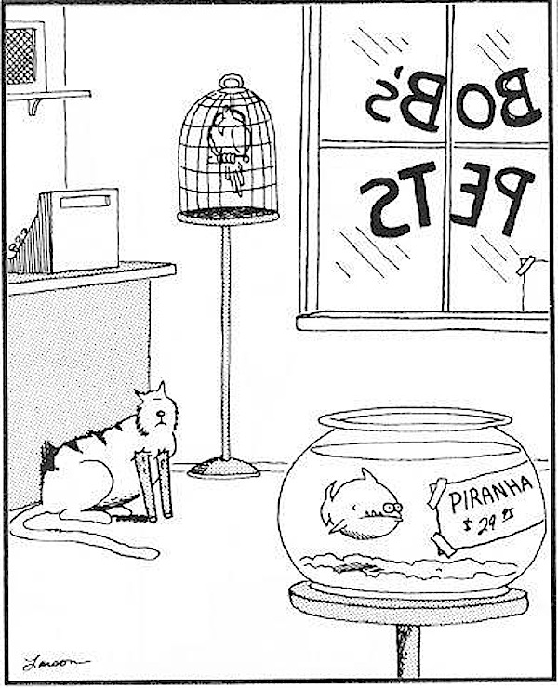
Observation vs. Inference
what you figure out
what you
see

Slide 6
Strategies for Making Inferences:
Look for details that reveal important aspects of setting, plot, and character.
Use common sense and prior knowledge to make connections.
Analyze a character's actions and words to determine his or her values.
Pay attention to how the narrator or characters make inferences.
Analyze your thought process and determine whether or not you are using faulty logic or jumping to conclusions.

Slide 7
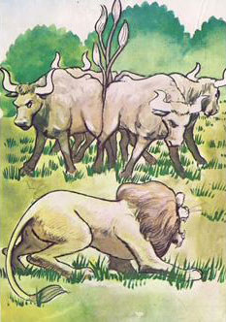
What’s the moral?
The Four Oxen and the Lion
A Lion used to prowl about a field in which Four Oxen used to dwell. Many a time he tried to attack them; but whenever he came near they turned their tails to one another, so that whichever way he approached them he was met by the horns of one of them. At last, however, they fell a-quarrelling among themselves, and each went off to pasture alone in a separate corner of the field. Then the Lion attacked them one by one and soon made an end of all four.

Slide 8
Character Refresher
Four ways to learn about a character:
What I look like (physical appearance)
What I say
What other characters say and think about me
How others react to me

Slide 9
Character Motivation: Reason behind a character’s behavior
You need to ask WHY a character behaves a certain way:
Find stated reasons in text
Look for clues:
background – age, description, home, etc.
speech, thought, actions, revealing expressions & gestures
key events – how the character interacts
Consider human nature – emotions shared by all, changes, common reactions (stress, fear, etc.)
Infer the motives

Slide 10
PALS reading
You will be using PALS step 3 to read the text today. Please follow the script.
You will need to WRITE down your 10 word summaries – each partner writes his or her own summary and keeps it in his or her own notebook.
Notes:
Stop after the second switch and discuss word choices – refer to word choice slide

Slide 11
Ticket out: Nov. 17
Write your name and today’s date.
How does Shirley Jackson seem to think or feel about Miss Strangeworth?

Slide 12
INDIVIDUALLY
Complete the character traits web for Mrs. Strangeworth.
Use specific words and details from the story to complete the web. These specific words will help you understand how Jackson uses her words to help create her theme.
Use your 10 word summaries to help you pinpoint where in the text you should go to find those specific words and details.

Slide 13
Individually
How did Shirley Jackson use repetition of words and phrases or unusual word choice to help show Miss Strangeworth’s characterization? \
Go through your notes and identify those repeated words or those unusual or unexpected words. These words also help us see Miss Strangeworth’s character.

Slide 14
Individually
What seems to be Shirley Jackson’s attitude towards Miss Strangeworth? What words and phrases show us this attitude?

Slide 15
LEQ 1:
How does Shirley Jackson use characterization and word choice to illustrate the difference between perception and reality in “A Possibility of Evil”?
Use your notes to help you answer this question. Use specific quotations too and be sure you explain why each quotation or example helps to show your answer to the question.

