Slide 1
Bellringer: Nov 4
In your NOTEBOOK.
What could symbolize your life right now? Explain.
For example, a symbol of Mrs. Bowe could be an APPLE because she is a teacher.
Another symbol of Mrs. Bowe at this point in her life could be a PAIR OF SNEAKERS because she likes to run.
Another symbol could be a I-95 because she uses that highway almost everyday and life for her is busy like I-95.

Slide 2
Theme review
Which of these is a theme?
1. Coming of Age.
2. Sandra Cisneros grew up without her father’s approval.
3.Growing up is a difficult process but everyone must do it at some point.
4. Being accepted for who you are is something that all people desire.

Slide 3
“Rites of Passage”
Remember when we looked at the “Rites of Passage”? – Get out that handout.
The main character in “Through the Tunnel” is about to undergo a rite of passage. As you read today, think about how his experiences compare to the stages in a rite of passage. This comparison will help you determine a theme.

Slide 4
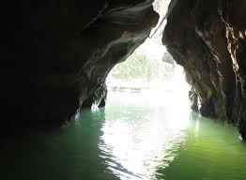
How do symbols develop theme?
“Through the Tunnel”
by Doris Lessing
Fun fact!
Lessing was born in Iran and spent much
of her childhood in Southern Rhodesia (Zimbabwe)
She dropped out of school at 13. (It was 1932) She then educated herself.
She recently commented that unhappy childhoods seem to produce fiction writers. "Yes, I think that is true. Though it wasn't apparent to me then. Of course, I wasn't thinking in terms of being a writer then - I was just thinking about how to escape, all the time.”

Slide 5
A Symbol
is a item that stands for something besides itself
it usually carries some part of the author’s theme.
Frequently, in a story, an object, a person, a color, etc. may appear that functions on two levels
Literal-it is the thing it is
Figurative-it has a hidden meaning that the author is hinting at

Slide 6
The Power of Environment (how setting can be symbolic)
Write down specific sensory details from the next 3 images.
What is the mood?
What details in the photo help determine this atmosphere (mood)
Share your results with a neighbor. Take note of similarities and differences.

Slide 7
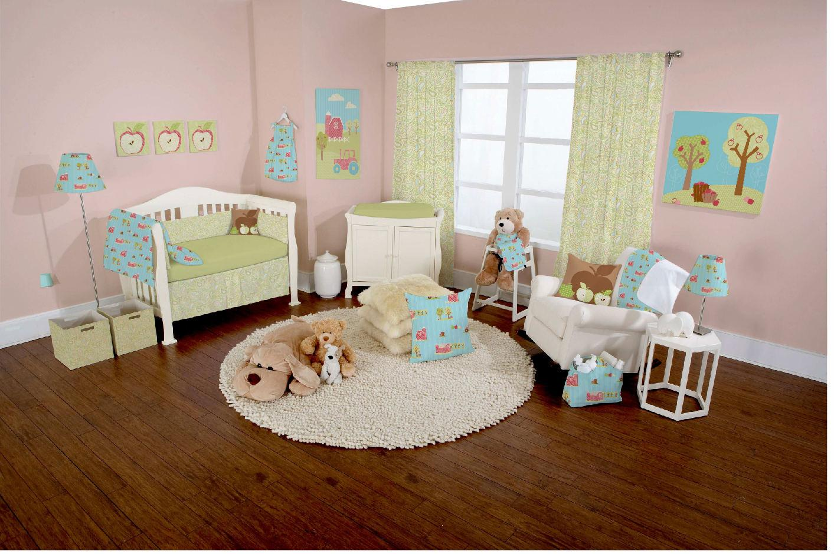
Sensory details/Mood/Atmosphere

Slide 8
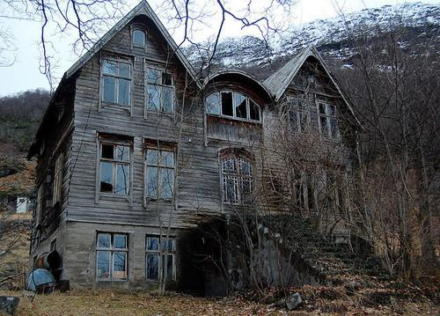
Sensory details/Mood/Atmosphere

Slide 9
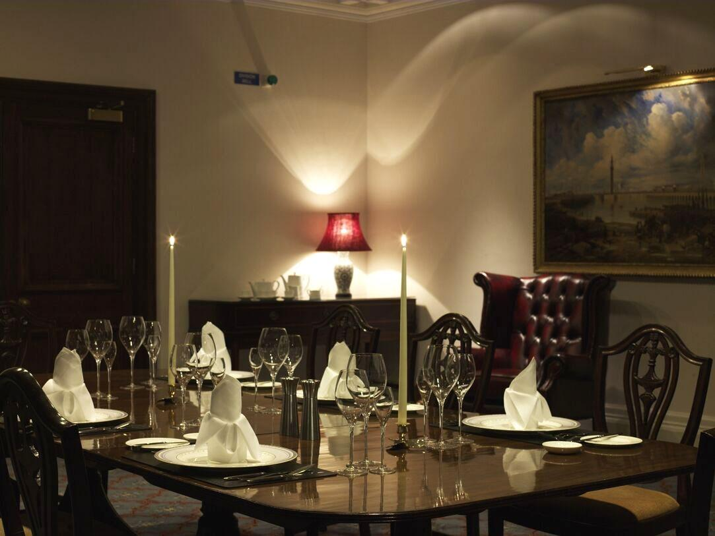
Sensory details/Mood/Atmosphere

Slide 10
Analyzing a poem for symbolism
Read the poem, “Fifteen”. (again!)
With your partner, underline the different elements of the setting. Next, write down what could be a symbolic meaning for those elements.
What message is the author conveying about the speaker through the setting? Write your response on the back. Use details to show your point.
Be prepared to share out.

Slide 11
“Our greatest weakness lies in giving up. The most certain way to succeed is always to try just one more time.” -Thomas A. Edison
Contrition Promontory Supplication
Luminous Sputtering Gout
Inquisitive Persistence Incredulous
Tenacity Importunity Diligent
Beseeching Clambered Minute
Finally, use 5 of them to answer the prompt below.
Prompt: What happens to a person when s/he achieves a goal? What motivates people to take risks?

Slide 12
Reading “Through the Tunnel”
Create this four category chart using the blank paper.
DETAIL ABOUT THE SETTING | POSSIBLE SYMBOLIC MEANING
Childish behavior | Adult-like behavior

Slide 13
Reading using PALS
We will be using steps 1, 2, and 3
Step 3 uses a timer Countdown Timer
Take notes on your chart as you read and remember to stop and discuss the pause and reflect questions.

Slide 14
Exit ticket -
Turn in the vocabulary activity.

