Slide 1
Bellringer Oct. 21
The following sentence contains either a single error or no error at all. If the sentence contains an error, select the one underlined part that must be changed to make the sentence correct. If the sentence contains no error, select choice E.
Encouraged (A) from her teacher, Vanessa (B) decided to enter the short story contest (C) with a story about her experience growing up (D) in Canada. (E) No error

Slide 2
Assessment
How does Sandra Cisneros carefully balance the words and details used to explain her family's effect on her development for her audience?
Your answer must include.
Specific details from the text.
All of the previewed vocabulary
Personal essay
Organization of details
Word choice
Imagery
Tone
Voice
Mood

Slide 3
How does Sandra Cisneros carefully balance the words and details used to explain her family's effect on her development for her audience?
1 – name the effect
2 – state how she builds her piece to create the effect
A. Order of details.
B. Types of Images she created (Voice)
C. CONSTRASTS she created. (TONE)

Slide 4
Submit your finished response
You worked on it last class and today.
We are moving on. If you aren’t finished, you need to submit your response on Thursday.

Slide 5
LEQ 2-How does Joanne Hyppolite control structure and literary devices to develop an argument in “Dyaspora”?
Moving on to the next part of Lesson 3!!!
This text is “Dyaspora” – you can find in on the online textbook.
What is it like to grow up between worlds?

Slide 6
Opening Question
Describe a time when you were being pulled between two worlds.

Slide 7
Listen-Read-Discuss
Today we are going to do something called Listen-Read-Discuss(LRD) to read a new piece of narrative-nonfiction.
LRD is a quick way to experience a text in a classroom.
It’s pretty simple.
First, we listen about the text.
Then, we read the text on our own.
Finally, we have a class discussion about the text.
Of course, we are also going to write at the end.

Slide 8
Background and Craft
Listen!

Slide 9
Background
A diaspora is a scattered population with a common origin in a smaller geographic area. The word can also refer to the movement of the population from its original homeland.

Slide 10
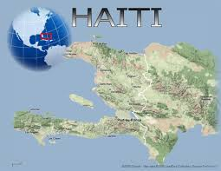
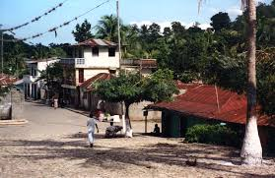
“Dyaspora” is a story of a Haitian girl growing up in the US

Slide 11
Haiti
A country southeast of Cuba.
Shares an island of Hispanola with Dominican Republic
Has a long history of conflict.
Europeans took control of the island and imported slaves
The slaves successfully fought off several European powers
The US even controlled Haiti during the early part of the US
Has been marred by frequent coups and political instability
Haiti ranked 145 of 182 countries in the 2010 United Nations Human Development Index, with 57.3% of the population being deprived in at least three of the HDI's poverty measures.[5]

Slide 12
Dyaspora

Slide 13
Brief Summary
This piece is about a woman growing up as a Haitian-American.
She talks about each of the specific places in her life and how it felt to live in each one.
She uses a lot of French words that would have been used by her Haitian family.
She talks about being part of a group, but struggling to fit into parts of American Culture
She writes about how reading and writing are a way to understand others and to help them understand you.

Slide 14
Read!
Silently, to yourself.
You have 15 minutes.
Feel free to annotate the text!

Slide 15
Discuss!
To successfully understand what the author is doing, we need to take a look at some literature vocabulary.
Organization
Topic sentences
Point-of View
Word choice
Tone

Slide 16
Discuss AND record!
Whenever you are evaluating a text, it is important to record the information that is discussed.
Like before, I will not be giving you a teacher-designed sheet to do this.
You are going to make your own.
Think about:
What literary elements we are focusing on?
What does evidence look like?
How can we organize it for efficiency?

Slide 17
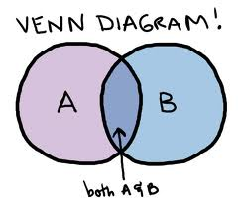
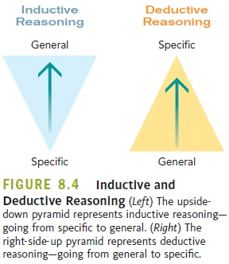
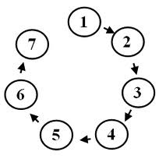
Part 1: Organization
You may remember being taught types of organization
Chronological
Compare and Contrast
Inductive
Deductive
Sequential
Spatial

Slide 18
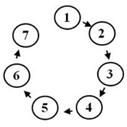
Organization
That doesn’t mean that writers are bound to these types
As we learned in the last lesson, most writing makes organizational decisions based on the author’s purpose, the intended audience, and the information that needs to be delivered.
A fiction story is usually chronological
Instructions are usually sequential
The chapter from Freakonomics was inductive overall, but compare/contrast in each section.

Slide 19
Organization
Organization is about looking at the information you have and thinking about the best order to give it to your audience.
The paragraph is the basic unit of organization.

Slide 20
Topic Sentences
How long is a paragraph?!
Your paragraph and its length are determined by their topic sentence.
A good topic sentence lets the reader know the content of the paragraph.

Slide 21
Let’s look back at the text!
Underline the topic sentences of each paragraph!
What is the organizational pattern you see here?
Why might the author choose this pattern? Discuss this with your partner for 1 minute before we come together as a class.

