Slide 1
Bellringer Period 3
Please read and then write your response to the text on your desk. You have 8 minutes from the beginning of class to accomplish this task.
Start time: 10:42.
End time: 10:50
Once completed, we will be working on “Dyaspora” – please have the text and your notes out on your desk by 10:50.

Slide 2
Bellringer Oct. 23 Periods 1 and 5
You don’t need to write this bellringer
The following sentence contains either a single error or no error at all. If the sentence contains an error, select the one underlined part that must be changed to make the sentence correct. If the sentence contains no error, select choice E.
Beluga whales, (A) which are also called sea canaries (B) because of their high-pitched chirps and gregarious natures, are the only animals
(C) known mimicking the sounds (D) of human speech spontaneously. (E) No error

Slide 3
Discuss!
To successfully understand what the author is doing, we need to take a look at some literature vocabulary.
Organization
Topic sentences
Point-of View
Word choice
Tone

Slide 4
Discuss AND record!
Whenever you are evaluating a text, it is important to record the information that is discussed.
Like before, I will not be giving you a teacher-designed sheet to do this.
You are going to make your own.
Think about:
What literary elements we are focusing on?
What does evidence look like?
How can we organize it for efficiency?

Slide 5
Message:
Brainstorm in your notes what message you think that Hyppolite is making with her narrative. It would be a message about life and about being a Dyaspora.

Slide 6
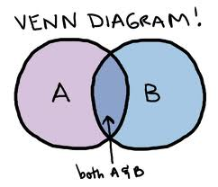
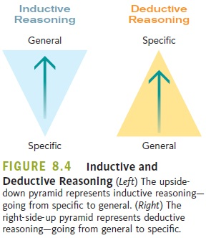
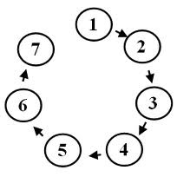
Part 1: Organization
You may remember being taught types of organization
Chronological
Compare and Contrast
Inductive
Deductive
Sequential
Spatial

Slide 7
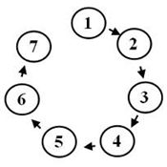
Organization
That doesn’t mean that writers are bound to these types
As we learned in the last lesson, most writing makes organizational decisions based on the author’s purpose, the intended audience, and the information that needs to be delivered.
A fiction story is usually chronological
Instructions are usually sequential
The chapter from Freakonomics was inductive overall, but compare/contrast in each section.

Slide 8
Organization
Organization is about looking at the information you have and thinking about the best order to give it to your audience.
The paragraph is the basic unit of organization.

Slide 9
Topic Sentences
How long is a paragraph?!
Your paragraph and its length are determined by their topic sentence.
A good topic sentence lets the reader know the content of the paragraph.

Slide 10
Topic Sentences

Slide 11
Let’s look back at the text!
Underline the topic sentences of each paragraph!
What is the organizational pattern you see here?
Why might the author choose this pattern? Discuss this with your partner for 1 minute before we come together as a class.
How does this pattern help reinforce her message?

Slide 12
Part 2: Point-of-View
The method of narration
There are three main types
1st person
3rd person
2nd person

Slide 13
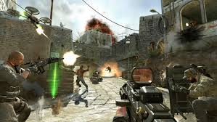
1st person
From the point of view of the author.
“I destroyed all the noobs.”
Good for letting you know the writer’s or main character’s true thoughts, and what it is like to be there.
These games are called First Person Shooters for a reason

Slide 14
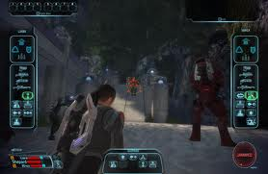
3rd person
From the point of view of someone watching the events from afar.
Limited-Don’t know everything
Omniscient-Knows everything
Good for showing numerous events in a text
“He decided staying home and playing Mass Effect was a better use of his time”

Slide 15
Let’s look back at the text: 2nd person
RARE!
Uses the pronoun “you”
“You are fighting a thousand bears, and you feel your strength failing you.”
An example from Dyaspora: “Your house in Boston is your island As the only Haitian family on the hillside you grow up on…”
AP 2: The question is...why use 2nd person? Discuss this with your elbow partner. Be prepared to explain to the class.

Slide 16
Part 3: Word Choice and Tone
Works on a spectrum of positive and negative connotations
Collective word choice creates tone
“I don’t like flamingoes. They are scary.”
“I detest flamingoes. They are terrifying”
“He gave her the present.”
“He tossed her the tattered present.”

Slide 17
Let’s look back at the text!
First – identify if the paragraph seems to have a positive tone, a negative tone, or a mixture of the two.
Next, using the tone wheel, come up with a emotion word that best describes each paragraph. Circle the words in the paragraph which helped you see that emotion.
Do you notice any shifts in tone between paragraphs?
AP 3: How does the tone of each paragraph and the tonal shifts between those paragraphs help you understand about the author’s life?
Discuss this with your partner for two minutes.
Discuss as a class.

Slide 18
Discussion

Slide 19
LEQ 2-How does Joanne Hyppolite control structure and literary devices to develop her message in “Dyaspora”?
Answer the LEQ using all of the literature vocabulary:
Organization
Topic Sentence(s)
Word Choice
Tone
Point-of-View

