Slide 1
BELLRINGER
ON SCRAP PAPER:
Write your name and today’s date.
What do you remember about persuasion from last year? Think about the characteristics of persuasive writing and record what you remember.

Slide 95
Now, onto part 2 of Lesson 2.
Just as we looked at chapter 2 of Outliers for how an author could structure an argument using narratives as examples, we will look at a section of Freakonomics to see how these authors structure their argument.
English class is no longer about what a text says, but how it is constructed and the effects of the author’s decisions. It will be hard. It will push you. If you hang in there, the world will make more sense and you will be a better educated person.
It is hard because you haven’t had ten years of doing this. You’ve had ten years of reading though. Did you put in all your hours of practice?

Slide 96
Modes of Discourse
Narration - one might think of it as telling a story
Description - to describe something—object, person, place, experience, emotion, situation, etc. (the goal is to paint an image that is vivid and moving in the mind of the reader).
Exposition - to investigate an idea, evaluate evidence, expound on the idea, and set forth an argument concerning that idea in a clear and concise manner. (This can be accomplished through comparison and contrast, definition, example, the analysis of cause and effect, etc.)
Argumentation - to investigate a topic; collect, generate, and evaluate evidence; and establish a position on the topic in a concise manner. This writing is similar to “exposition,” but requires more extensive research. It also involved addressing the opposing side and rebutting their key points.

Slide 97
Freakonomics
“What Makes a Perfect Parent?”

Slide 98
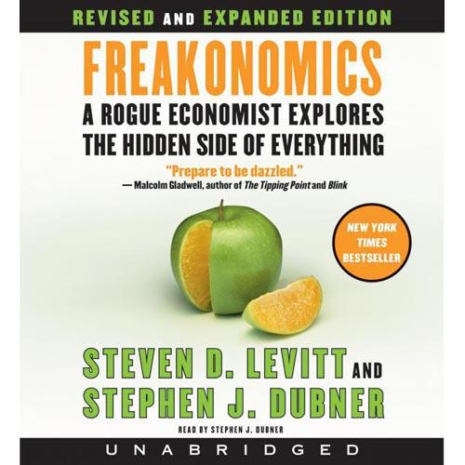

Slide 99
What’s this book about?!?
The book is a collection of 'economic' articles written by Levitt, an expert who has already gained a reputation for applying economic theory to diverse subjects. In Freakonomics, Levitt and Dubner argue that economics is, at root, the study of incentives.
The book's topics include:
Chapter 1: Discovering cheating as applied to teachers and sumo wrestlers, as well as a typical Washington DC area bagel business and its customers
Chapter 2: Information control as applied to the Ku Klux Klan and real-estate agents
Chapter 3: The economics of drug dealing, including the surprisingly low earnings and abject working conditions of crack cocaine dealers
Chapter 4: The role legalized abortion has played in reducing crime, contrasted with the policies and downfall of Romanian dictator Nicolae Ceauşescu
Chapter 5: The negligible effects of good parenting on education
Chapter 6: The socioeconomic patterns of naming children
--Wikipedia

Slide 100
Circle the 8 factors which you believe matter to a young child’s success in school
The child has highly educated parents.
The child’s family is intact.
The child’s parents have high socioeconomic status.
The child’s parents recently moved into a better neighborhood.
The child’s mother was thirty or older at the time of her first child’s birth.
The child’s mother didn’t work between birth and kindergarten.
The child had low birthweight.
The child attended Head Start (federally funded pre-K)
The child’s parents speak English in the home.
The child’s parents regularly take him to museums.
The child is adopted.
The child is regularly spanked.
The child’s parents are involved in the PTA.
The child frequently watches television.
The child has many books in his home.
The child’s parents read to him nearly every day.

Slide 101
Chapter 5: “What Makes a Perfect Parent?” Here’s the backstory…
The chapter begins by reviewing how parents get educated on raising their children and how parenting experts swing from one extreme to the next to “sell” their ideas.
parenting types
pro co-sleeping Vs anti co-sleeping
The authors considers what motivates parents to worry more about certain risks than others (swimming pools vs. guns) focusing on the effects of fear and misinterpretation of data.
how to sell using fear!

Slide 102
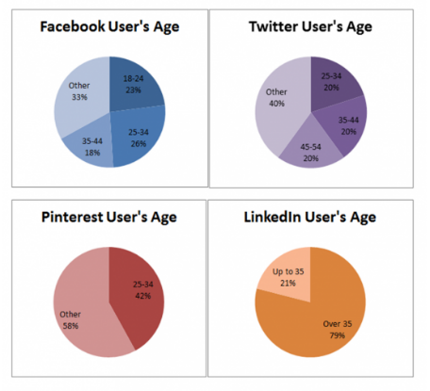
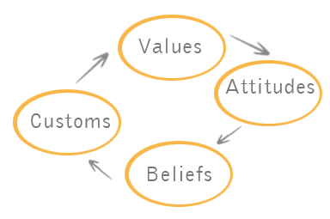
The chapter examines the influence of demographics, culture, and other variables that affect students’ performance on standardized tests.
?
SAT

Slide 103
Bottom Line
A successful child appears to be more “made” than nurtured.
(How is this similar to what we discovered with Outliers?)

Slide 104
Who do you think is the primary audience for this book?
Hostile? Why would they buy this book?
Wavering? What would appeal to them about this book?
Supportive? What would they already be interested in to buy this book?

Slide 105
Vocabulary!
ECLS:
Stands for Early Childhood Longitudinal Study. The project measures the academic progress of over 20,000 children from kindergarten through fifth grade with subjects that represent a cross section of American children. example
correlation:
A statistical term that indicates whether two variables move together.
Example:
cold & snow are positively correlated
Sun and rain are negatively correlated
what do these correlations look like?
regression analysis:
How an economist sorts huge piles of data to determine which factors are correlated and which are not.
It demonstrates correlation, but doesn’t prove cause.
why is it called regression?

Slide 106
Read the text.
As you read, keep track of whether or not you were correct about your predictions (from the circle eight activity).
Your explanations for why you were correct or incorrect must include information from the text. Use specific details.

Slide 107
EXIT TICKET
Make a prediction.
Why would an author save his thesis until the end of his argument?

