Slide 1
Bellringer: Sept 15
ON the piece of scrap paper I gave you, write your name, the date, and the period.
Answer this question (no, you don’t need to write it)
What literary element does Kipling use the most effectively in “If”? (look in your notes to help you)
Leave room on your paper for today’s exit ticket
Be ready to turn in this paper.
No, you may not go to the bathroom to fix your hair, make-up, etc.

Slide 2
Pictures:
We will report to the auditorium at _12:50 period 8_
Line up and pay attention to the photographers.
Sit in the designated area when you are finished.
Report back to W202 in a timely manner.
If you are super late in returned to the classroom, I will be writing up a referral for loitering.
If you are loud in the hallways, I will be writing a referral for general disturbance of the classroom environment and defiance.
Notes:
Period 2 – 10:00; Period 4 - 12:50; Period 5 – 7:45; Period 7 – 10:50; Period 8 – 12:50

Slide 3
Reviewing the last week’s quiz
It was out of 16. Passing is 10 out of 16.
Questions 1-5 are 1 point
Question 6 is 3 points
Question 7 is 2 points
Question 8 is 6 points. If you scored a 3, you didn’t explain your answer fully or did not explain what your evidence means. If you scored a 0 you didn’t use any evidence or your response did not correctly address the question.

Slide 4
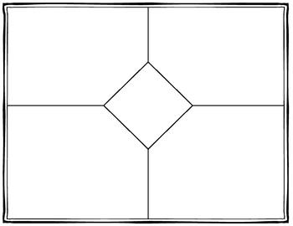
“Fifteen” by William Stafford
Make a new foldable.
Repetition
Figurative Language (Personification, symbol, metaphor, and simile)
“Fifteen” Stafford
Rhyme
Imagery

Slide 5
Backside of foldable
Stanza 1
Stanza 2
“Fifteen”
Stafford
Tone
Stanza 3
Stanza 4

Slide 6
Read the poem
Door Partner: Read stanza 1 and 2 to your Window partner
Window Partner: summarize what happens in stanza 1 and 2 to your partner.
Window Partner: Read to the end of the poem to your Door partner
Door Partner: summarize what happens to your partner.

Slide 7
Make your notes.
1. Add details for each category to your foldable notes.
2. Decide on the tone (the author’s attitude (feelings) toward the subject)
Find examples from each stanza which help you see this one tone.
3. Decide what possible theme (message) the author has created. HINT: The topic is growing up.

Slide 9
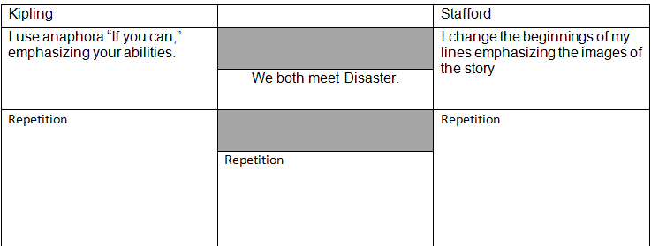
Complete the graphic organizer and then accompanying writing assignment.
This writing assignment does count as a writing category grade.

Slide 10
Exit Ticket
ON your bellringer paper, which I have returned during class, answer this question. (no, you do not need to write the question)
What do you think is the biggest influence on a child which determines whether or not he or she will be successful as an adult? Explain.
Homework – JUST complete the graphic organizer for next class. Use your two foldable notes for the poems to help you.

