Slide 1
Bellringer: Sept 21
Get a computer and log into your profile.
Make sure the computer is working.
Then, don’t do anything with it.

Slide 2
Taking the SRI
Because you must

Slide 3
What is the SRI?
SRI stands for Scholastic Reading Inventory
It is a test to see how well you read at a fundamental level.
It takes less than 45 minutes.
The questions involve reading a short passage and answering a brief multiple choice question.
The test adapts to your answer to be more accurate.

Slide 4
Yay, another test…
This is a chance to demonstrate how well you can read.
The scores will help your teachers be more effective in teaching your class.
The scores will help your counselors place you in reading seminar classes if you need them. Reading seminar classes will help you become a better reader and improve your success in LIFE.

Slide 5
What if I don’t want to try?
This score will determine if you need an additional reading class or if you can come out of the one in which you are currently enrolled.
This test will be used multiple times to determine readiness for the next grade.
You may be given extra work.
Why not? What are you afraid of?
Guessing on this test ends very badly because it is adaptive. (It adjusts its level of difficulty based on your responses)

Slide 6
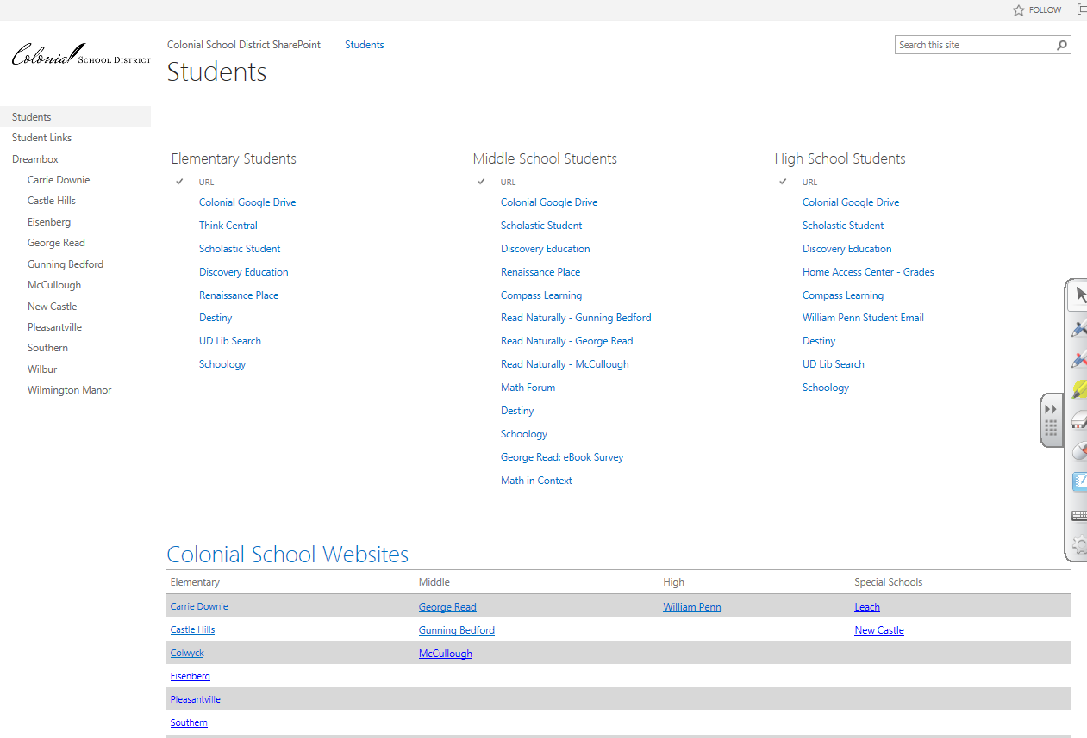
Alright! I’m Convinced. Bring it on!
Log on to the computer.
Open up Internet Explorer (not Firefox, not Chrome)
You should see this.

Slide 7
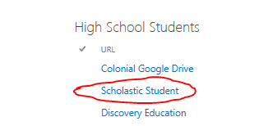
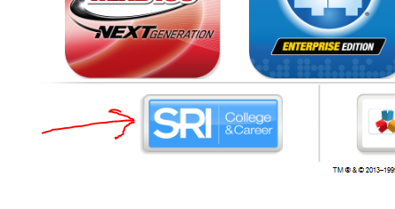
Alright! I’m Convinced. Bring it on!
Click Scholastic Student
On the new page, click SRI College & Career

Slide 8
Log In!
Use the same login as you did for the computer.
Username: Student ID#
Password: 8-digit birthday

Slide 9
Take the test!
It will ask you the types of books you like. Choose several categories. Then click next and follow the directions.
When you are finished please let me know, and I will give you further directions. Don’t log off without giving me your score!

Slide 10
After the test!
When you are finished, go to http://wpboweela.weebly.com
Find your class’s link. Answer the question I have posed for today on the sheet of paper I gave you.
Find the lesson resources link. Open it. Record what lesson 2’s question is on the paper I gave you.
Click on one of the vocabulary words in lesson 2. Record the word you chose and the definition on the paper I gave you.
Work on your rough draft of your poetry response.
Work on your unit project drafts.

Slide 11
Exit Ticket
On the paper I gave you, answer this question:
Why is being a better reader something that you should work to improve, even if you consider yourself a good reader?

