Slide 1
Bellringer Sept. 11
Get out your “If” poem and notes.
Identify one place in the poem where Kipling seems to address the idea of having balance. Highlight, circle or box this idea.

Slide 2
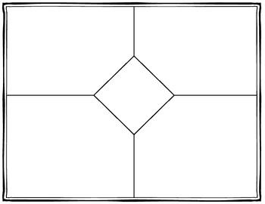
Re-read the poem so that it is fresh today.
Add more details to your notes in each of the categories on the front. Choose examples which seem to you to be important.

Slide 3
Find the pattern!
Once you have finished compiling your examples, examine the examples.
You should have examples from all of the stanzas – not just one or two.
What do they have in common?
How do the examples help emphasize the same idea(s)?

Slide 4
What is the tone? (Kipling’s attitude towards becoming a man?)
Check out the tone wheel to help you find specific words to describe the tone.
Put the tone in the center box and then find at least one example in each of the stanzas which you say helps to show that tone.

Slide 5
Write a letter to the absent kid (This is an assignment which will be graded and which you handed in today.)
Dear __________,
We read “If” by Rudyard Kipling. The poem is about what it takes to become a man. His theme is: __________________________. He creates this theme by:
(explain how he creates the theme: use examples from each card; BALANCE; “quotations from the poem” – explain how each example and quotation fits the theme)

Slide 6
Take the quiz!
This quiz is short and you only have today.
You may use your notes to help you.

Slide 7
Due today
Signed parent page of the course description.
Today is the last penalty free day to submit the summer reading for students who were at Penn last year.
(those of you new to the school, you have a due date which I set individually with you)
Vignettes are late! You only have a short time to get in late work!
Coming up
Picture day is next class.
We will be starting the next part of this lesson with “Fifteen” by Stafford

