Slide 1
Bellringer: What are the potential fates of humanity?
Unit 4 question - answer in your notebook.

Slide 2
“There Will Come Soft Rains"
Before 1900, electric machines were used primarily workplaces. With the spread of electricity, however, families enjoyed modern appliances in their homes. In the early 20th century, many household machines, such as the vacuum cleaner and the toaster, became available for the first time. Houses which talk to you and which anticipate your needs are now on the horizen.

Slide 3
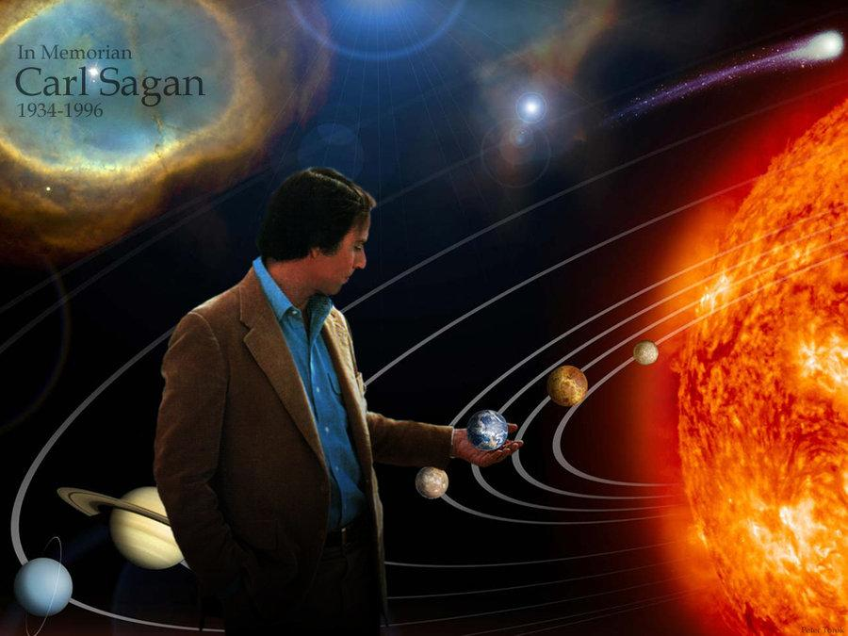
Nuclear Disarmament
-Written by Carl Sagan
-The Cold War
- Should we have nuclear bombs?
- More and more countries have nuclear bombs. Is that right?

Slide 4
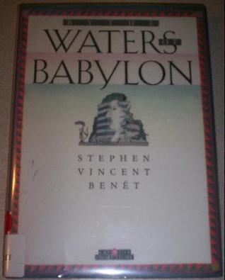
“By the Waters of Babylon”
The title of this selection is an allusion, or reference, to Psalm 137 in the Bible. The psalm expresses the sorrow of the Jews over their enslavement in Babylon and the destruction of Zion, their homeland.

Slide 5
Restoring Faith
Video: Restoring Faith In Humanity
Check this one out on your own

Slide 6
Open-ended Discussion Questions
What if you couldn’t fail?
What would make the world safer?
Can humanity triumph over evil?

