Slide 1
Unit 4: Knowing Our Fate
UEQ: What will become of humanity?

Slide 2
Discuss the following with your partner What are the potential fates of humanity? How do you think the world will end?

Slide 3
Bellringer – Period 1
Go back in your groups for the PSA project. We will be completing it today but it will not take the entire class period.

Slide 4
Unit 1: Knowing Yourself
Unit 2: Knowing the World
Unit 3: Addressing Intolerance
Unit 4: Knowing our Fate
This unit explores one of the issues humanity faces: our destructive technology (Nuclear Weaponry)

Slide 5
Key Terms:
The Cold War
A war that is waged without open combat.
The decades long conflict between NATO (us) and the Warsaw Pact (the Soviets)
Dr. Seuss’ The Butter Battle Book is an analogy for the Cold War
Notes:
http://bryanmiddle.ops.org/Portals/0/staff_folders/t_rutherford_matt/Butter%20Battle%20Show_pptx.pdf - PDF

Slide 6
Key Terms
Nuclear Fallout:
Fallout is residual radioactive material propelled into the upper atmosphere following a nuclear blast or a nuclear reaction conducted in an unshielded facility, so called because it "falls out" of the sky after the explosion and shock wave have passed.
Can cause: immediate death, cancers, birth defects...

Slide 7
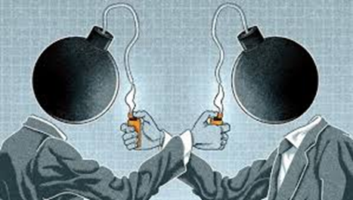
Key Terms
Mutually Assured Destruction (MAD)
the idea that no side will begin a nuclear war because, in the event of a nuclear war, both sides will be completely destroyed regardless of who attacks first.

Slide 8
What does a nuclear weapon and blast look like?
Here is what the military filmed back in the 1950s: “Survival Town” Atom Test

Slide 9
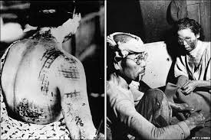
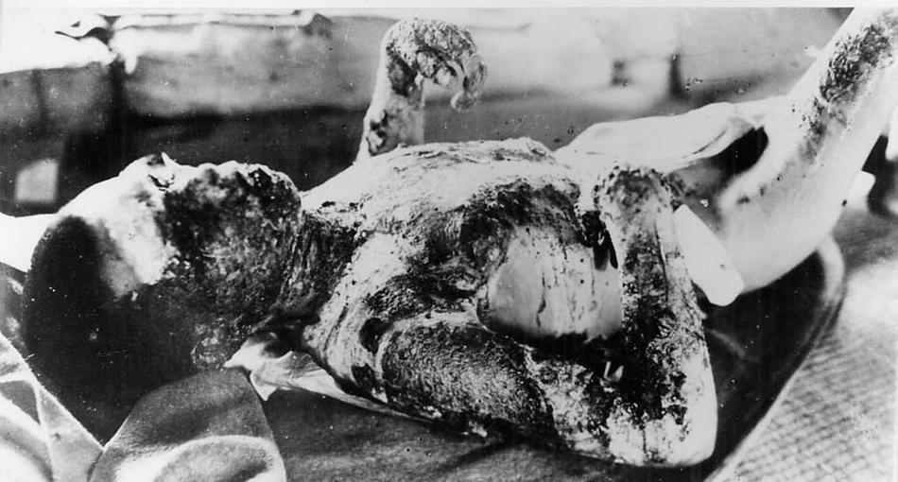
Effects of Radiation exposure

Slide 10
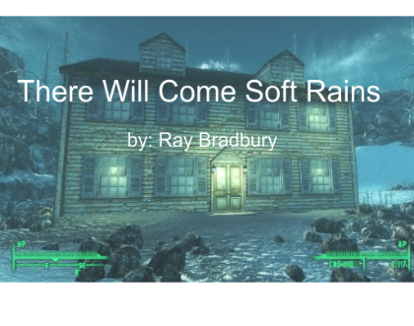
Key Text: “There Will Come Soft Rains“ by Ray Bradbury
Before 1900, electric machines were used primarily in workplaces. With the spread of electricity families enjoyed modern appliances in their homes. In the early 20th century, many household machines, such as the vacuum cleaner and the toaster, became available for the first time. Houses which talk to you and which anticipate your needs are now on the horizen. However, can this technology prevent our destruction?

Slide 11
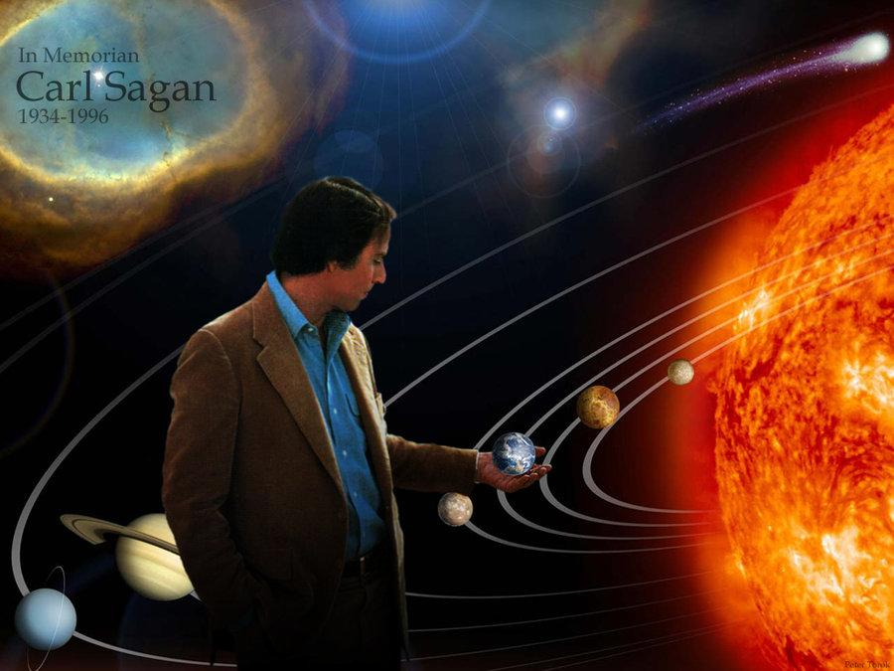
Key Text: “Nuclear Disarmament: Thoughts on the 125th Anniversary of the Battle of Gettysburg”
- by famous scientist Carl Sagan
-The Cold War
- Should we have nuclear bombs?
- More and more countries have nuclear bombs. Is that okay?

Slide 12
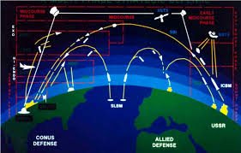
Key Text: National Security and SDI
By President Ronald Reagan
Keeping the world safe from nuclear threat
The technology was nicknamed “Star Wars”
How many nuclear weapons is enough?

Slide 13
Key Text: Dr. Strangelove or How I Learned to Stop Worrying and Love the Bomb
Political satire
Can we trust our politicians and military leaders?
What is stopping the one nut-job with nuclear access?

Slide 14
Exit Ticket: Pick one of the questions and respond
What would make the world safer?
Can humanity triumph over evil?

Slide 15
Answer these questions with your partner…
What would make the world safer?
Can humanity triumph over evil?

Slide 16
Bellringer – 4/13/16
Grab a textbook before the bell rings
Think about the following and be prepared to share:
What do you think would happen to humanity when technology begins to fail us?

Slide 17
“There Will Come Soft Rains” – page 306
Written by Ray Bradbury
Published for the first time in a magazine in 1950
Discusses the aftermath of nuclear war and how technology interacts with human kind
*Pay attention to the dog and the house*

Slide 18
“There Will Come Soft Rains” - Poem
Connotation – positive, negative, or neutral (hint: it’s not neutral)
Tone – the author’s attitude towards the subject
Diction – word choice
Figurative language – metaphor/simile, imagery, personification
Rhyme Scheme – labeling based on sounds - AABB etc.
Theme – the author’s message (universal idea)

Slide 19
“Americanah”
Stylistic devices that are important in reading this book:
Imagery
Symbolism
Organization/Structure
Narrative
Point of View

Slide 20
“Americanah”
What is this novel dealing with thematically?
Race
Identity
Separation vs. Connection
Notes:
Imagery, symbolism, organization and structure

Slide 21
Schoology Assignment
Schoology Assignment (all parts) due on Sunday, April 17.
If you do not have a computer at home, make arrangements to stay after school.

Slide 22
Exit Ticket - Honors
What are your first impressions of Americanah? What are you the most interested in talking about (thematically or stylistically) with this story?
MAKE SURE YOU HAVE A TEXTBOOK ON YOUR DESK

Slide 23
Period 7 - Bellringer
What is the difference between the theme of “There Will Come Soft Rains” the poem and “There Will Come Soft Rains” the short story?
Talk about it with your partner, and come up with any questions you have before the quiz.

Slide 24
Irony
Definition:
When words are used in such a way that they don’t mean what they say
What you expect to happen does not happen

Slide 25
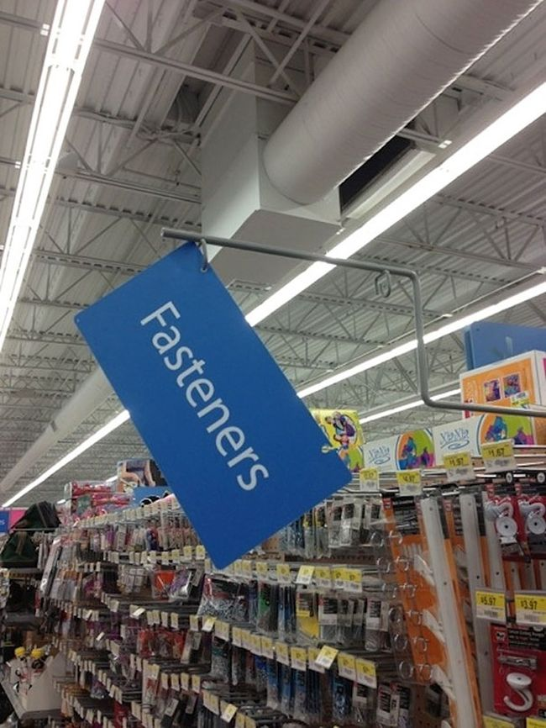

Slide 26
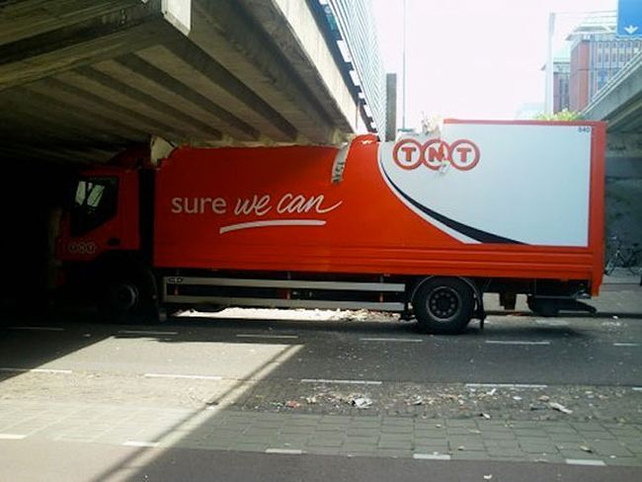

Slide 27
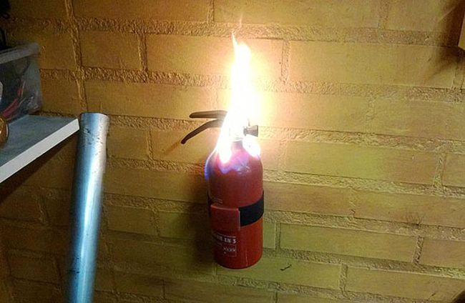

Slide 28
“There Will Come Soft Rains”
What examples of irony are present in the short story? Talk about it with your partner and be prepared to share.

Slide 29
Writing Assignment:
Write down an example of irony that you found in “There Will Come Soft Rains.” Explain why it is ironic, and how it connects to the overall theme of the story as a whole.
Also, include a section in which you describe the purpose and context of the poem. Why is it in the story?
This response needs to be at least 2 paragraphs with direct quotes/evidence from the text.

